Slide 1
THINC MAKERSPACE
BLUEPRINT & DESIGN PROPOSAL

Slide 2
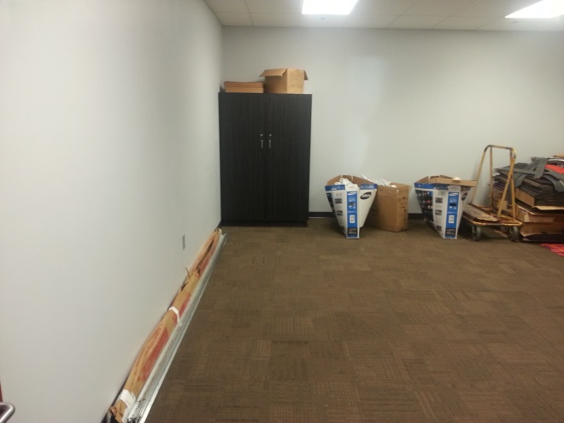
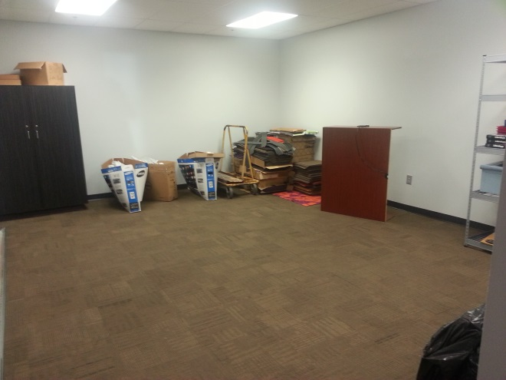
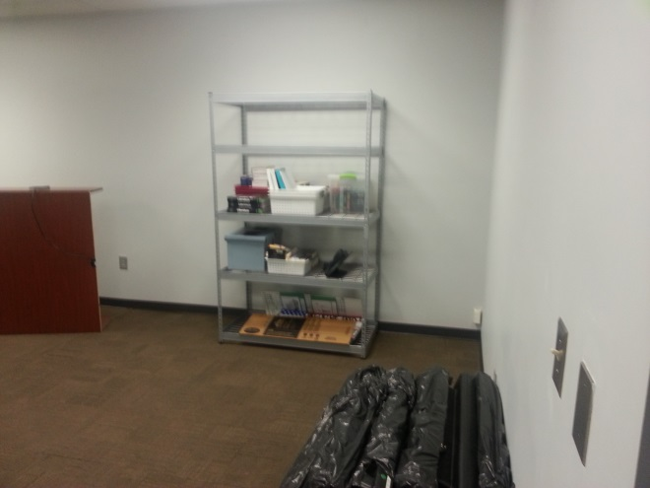
CURRENTLY
THE AREA IS CURRENTLY USED FOR STORAGE.
IT IS A RATHER SPACIOUS AREA,
MEASURING APPROXIMATELY 17’ X 22’

Slide 3
ACTUAL PHOTOGRAPHS
THE NEXT SECTION PROVIDES ACTUAL PHOTOGRAPHS OF THE AREA INTENDED FOR USE AS A MAKERSPACE
THESE PHOTOGRAPHS WERE TAKEN BY STUDENTS, AND USED AS REFERENCE WHILE DRAFTING THEIR INITIAL DESIGN PROPOSAL

Slide 6
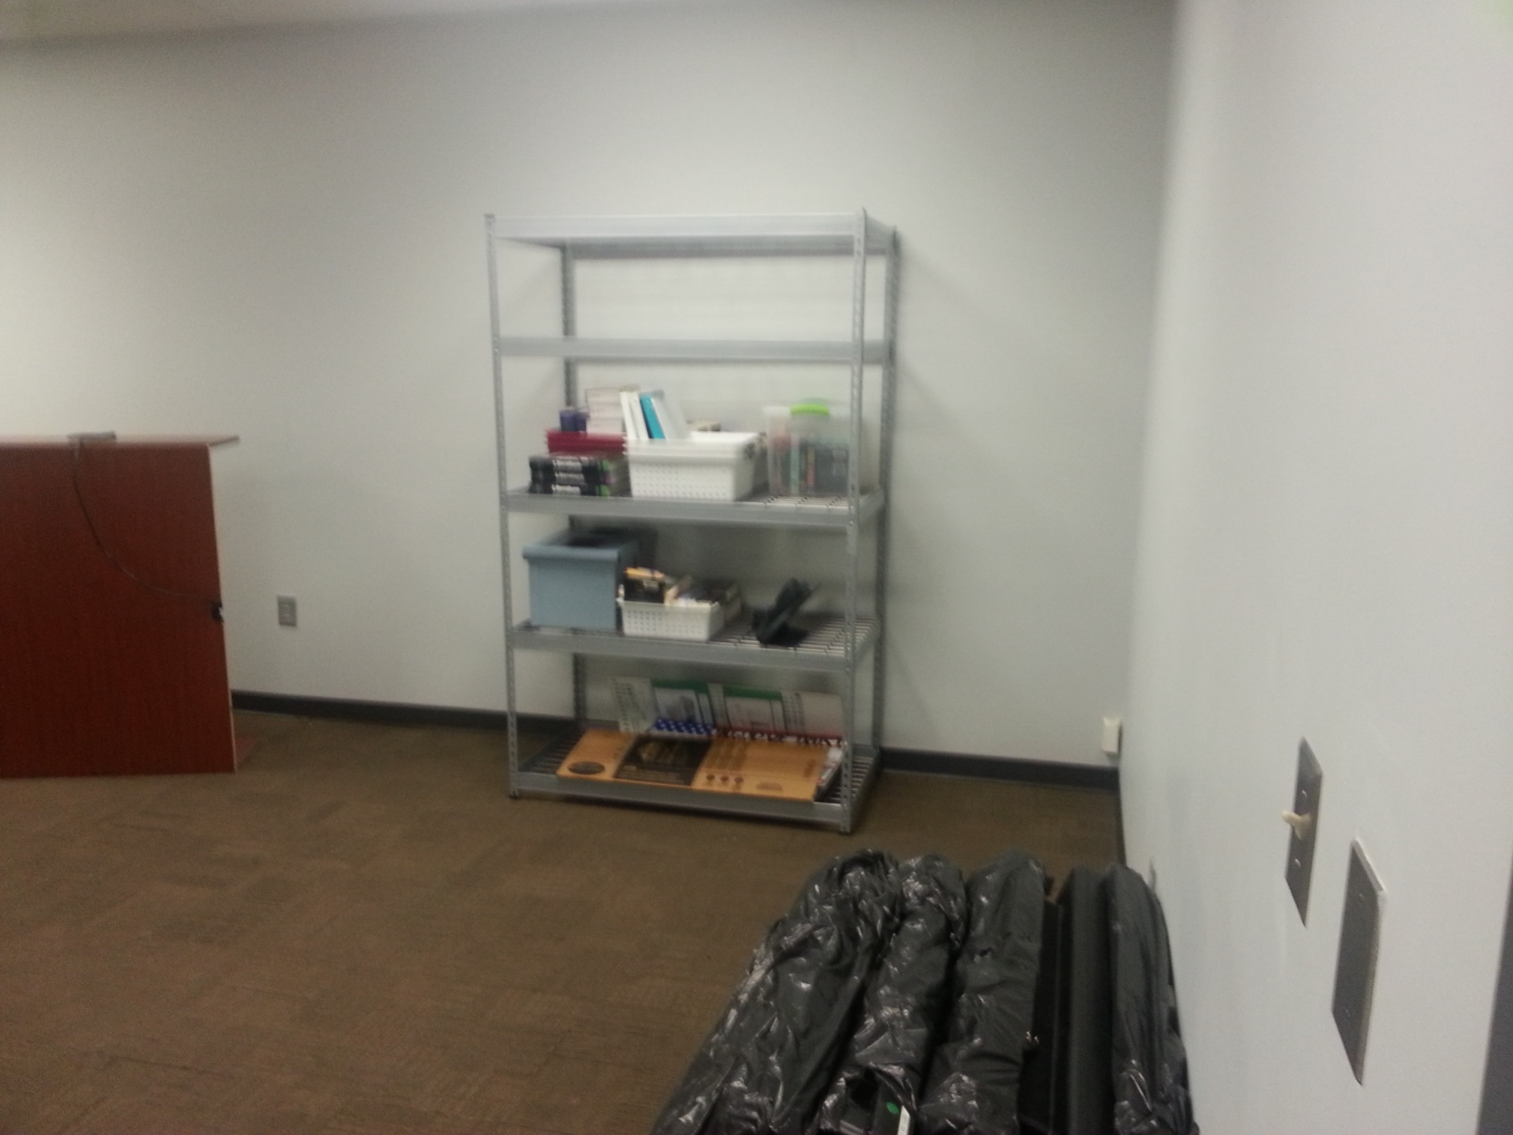

Slide 7
INTITIAL DESIGN PROPOSAL
THE FOLLOWING SECTION SHOWS THE INITIAL DESIGN PROPOSAL FOR THE AREA INTENDED FOR USE AS A MAKERSPACE
THIS DESIGN WAS CREATED USING AUTOCAD SOFTWARE

Slide 8
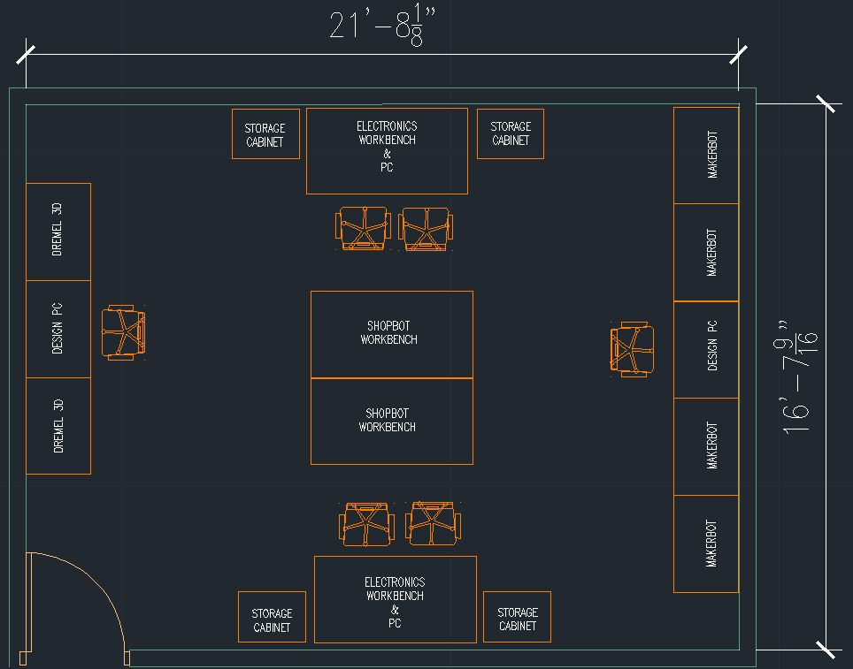
INITIAL DESIGN PROPOSAL

Slide 9
REVISIONS
AFTER COLLABORATING WITH INVOLVED PARTIES, SMALL REVISIONS WERE SUGGESTED.
REVISIONS ARE DOCUMENTED ON THE FOLLOWING SLIDE, AND ARE REFLECTED IN THE 3D RENDERINGS INCLUDED LATER IN THIS PRESENTATION

Slide 10
REVISIONS
TWO STANDARD WORKBENCHES REPLACED WITH ONE OVERSIZED WORKBENCH
WORKSTATIONS MOVED TO CORNER TO ACCOMMODATE TOOLBOX PLACEMENT

Slide 11
3D RENDERED DESIGN
THE FOLLOWING SECTION SHOWS THE REVISED DESIGN PROPOSAL FOR THE AREA INTENDED FOR USE AS A MAKERSPACE
THESE DESIGNS WERE CREATED USING SKETCHUP

Slide 12
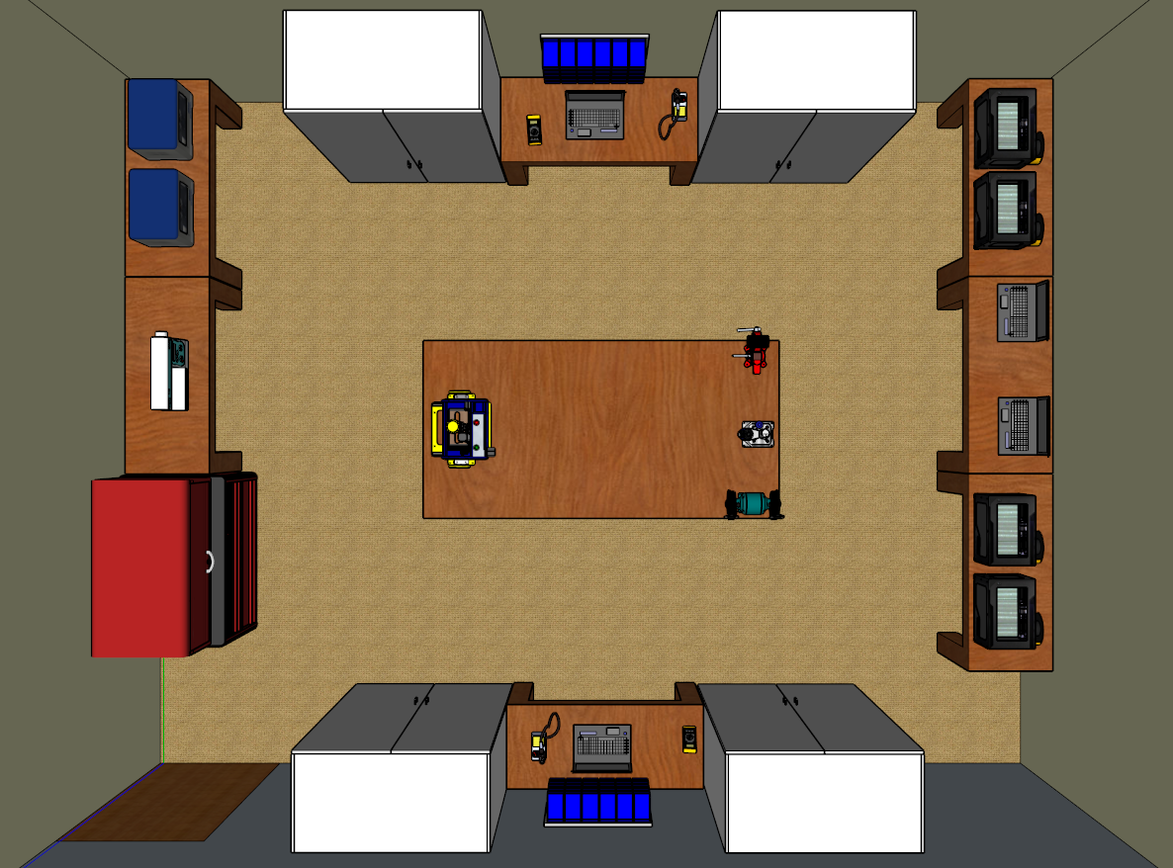
AERIAL VIEW

Slide 13
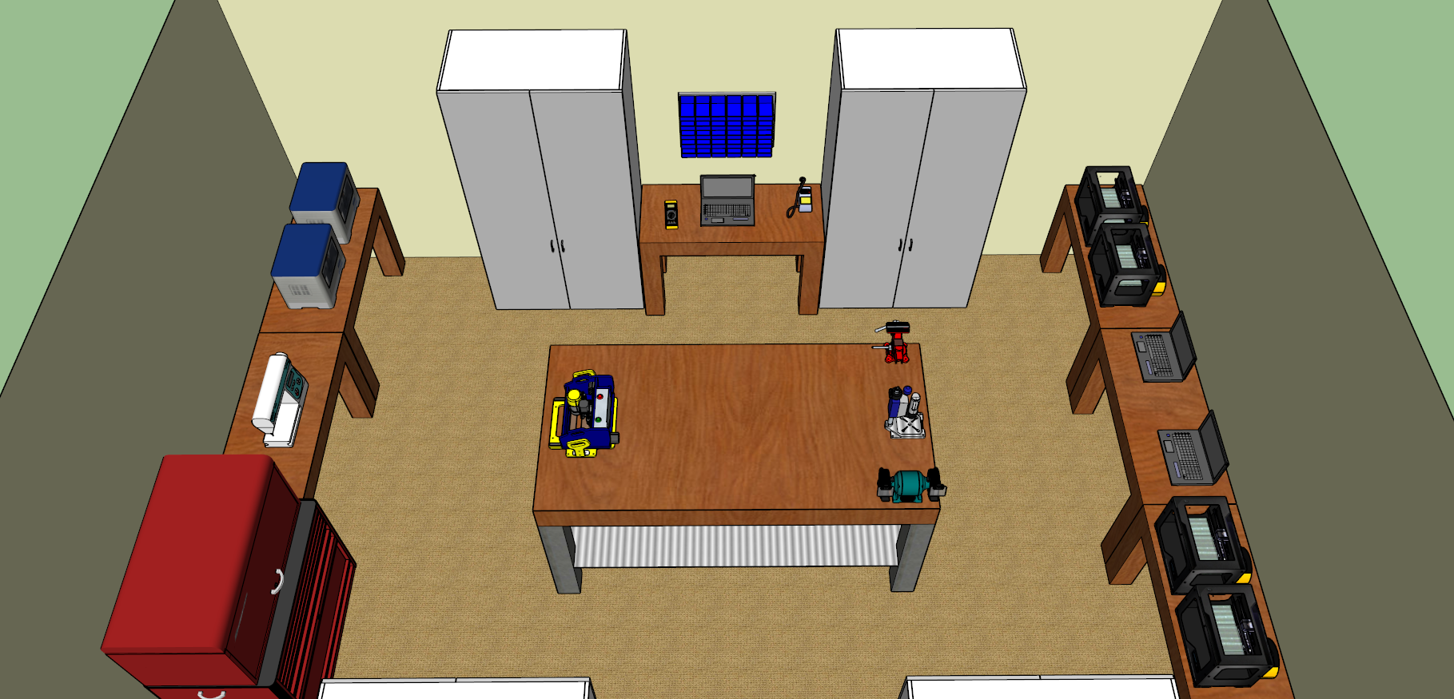
VIEW FROM NORTH

Slide 14
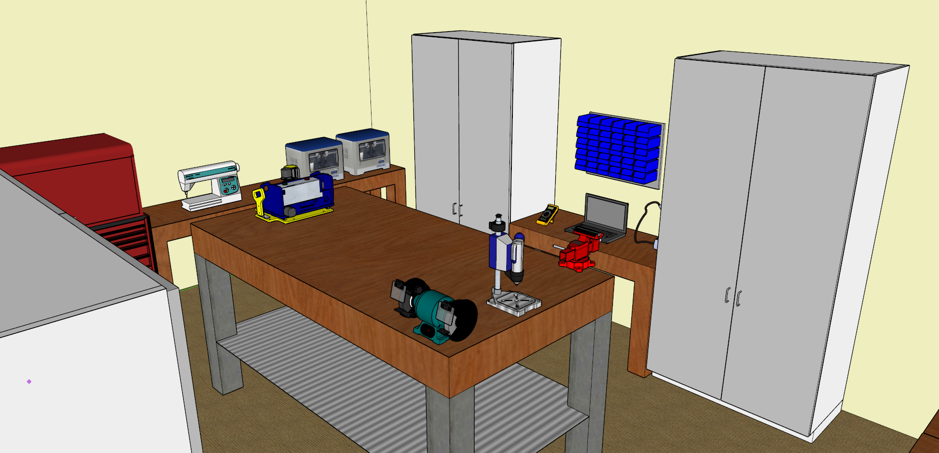
VIEW FROM NORTHWEST

Slide 15
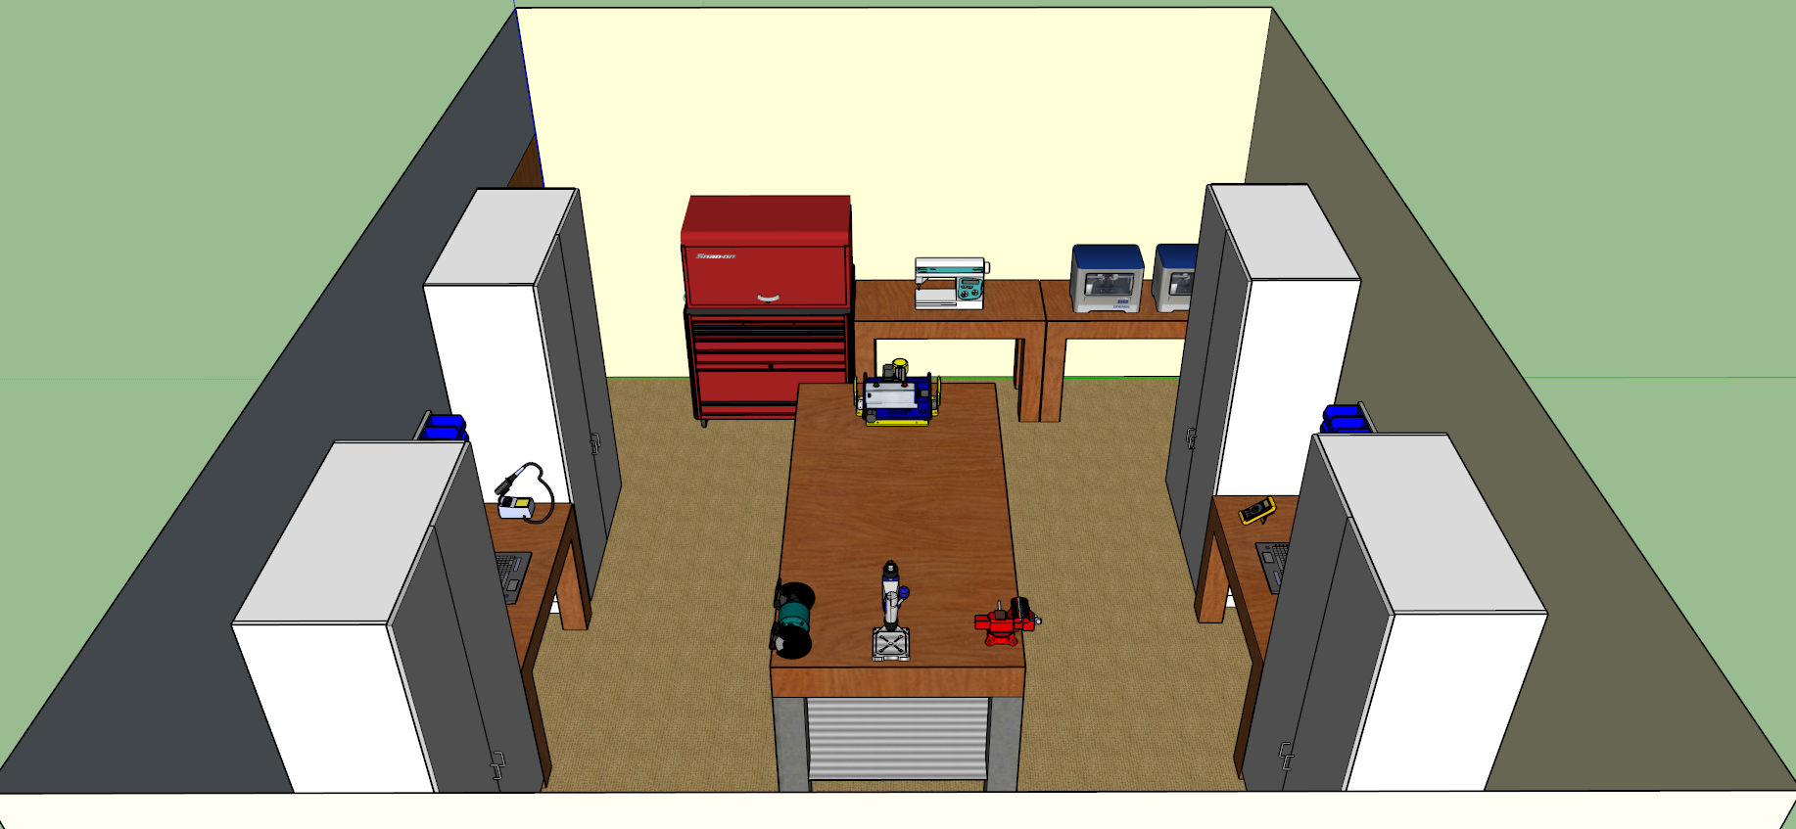
VIEW FROM WEST

Slide 16
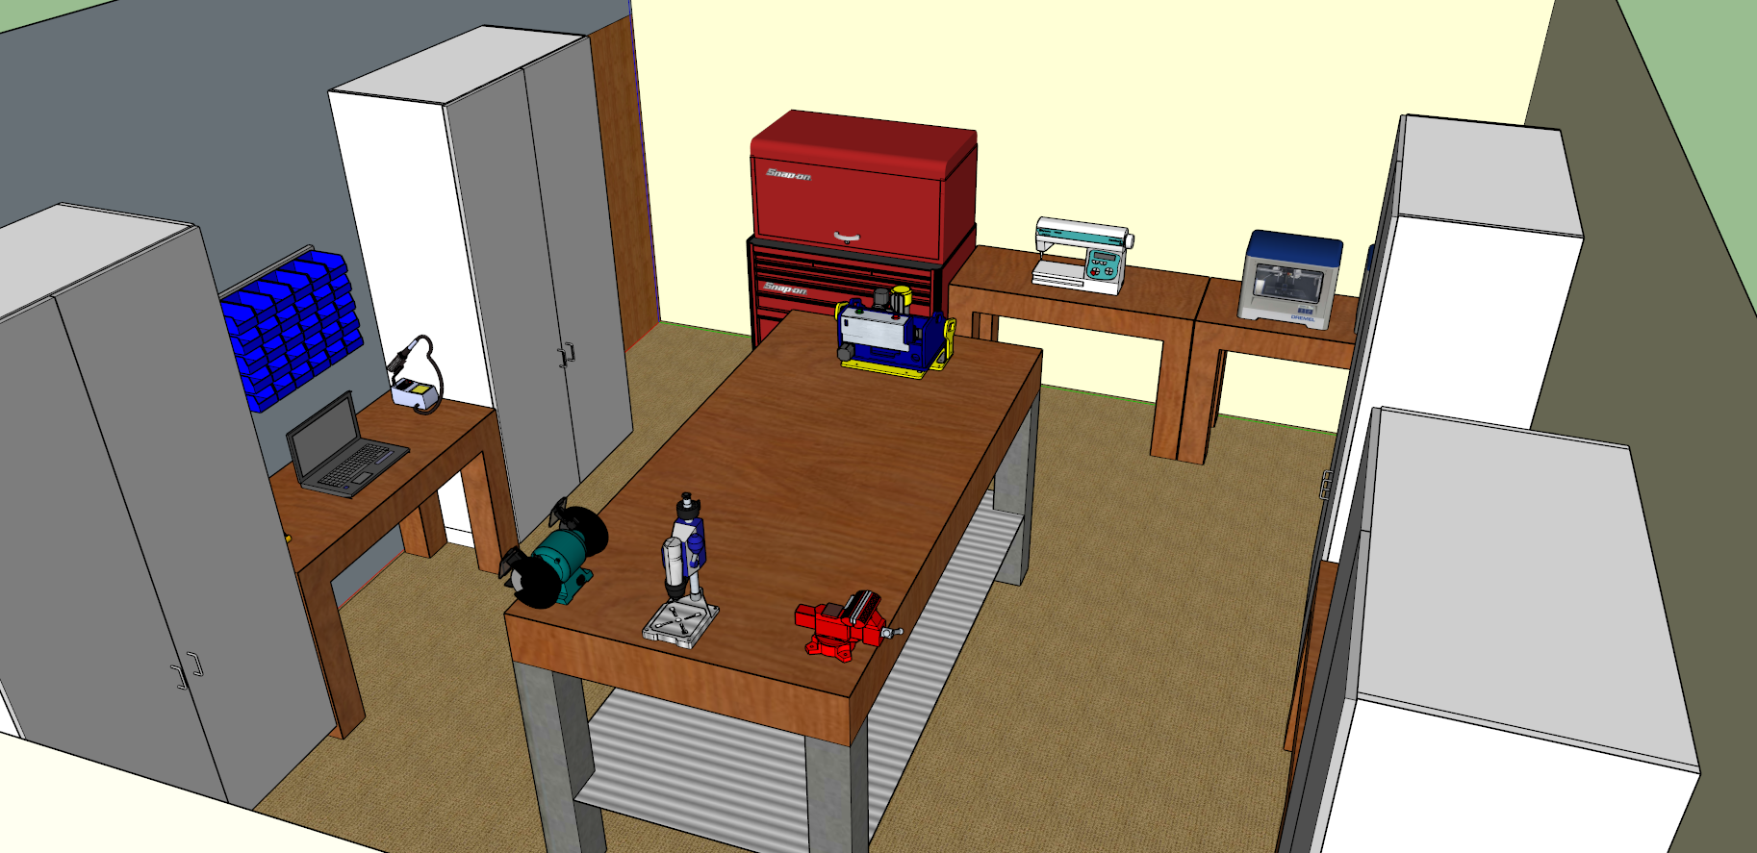
VIEW FROM SOUTHWEST

Slide 17
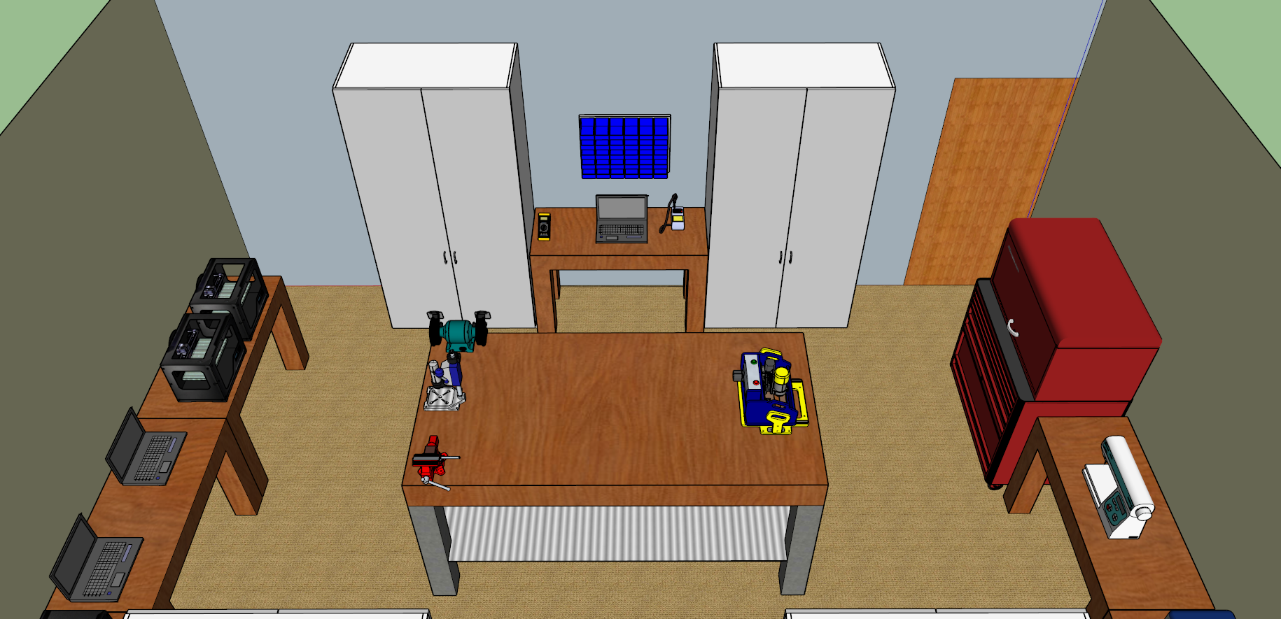
VIEW FROM SOUTH

Slide 18
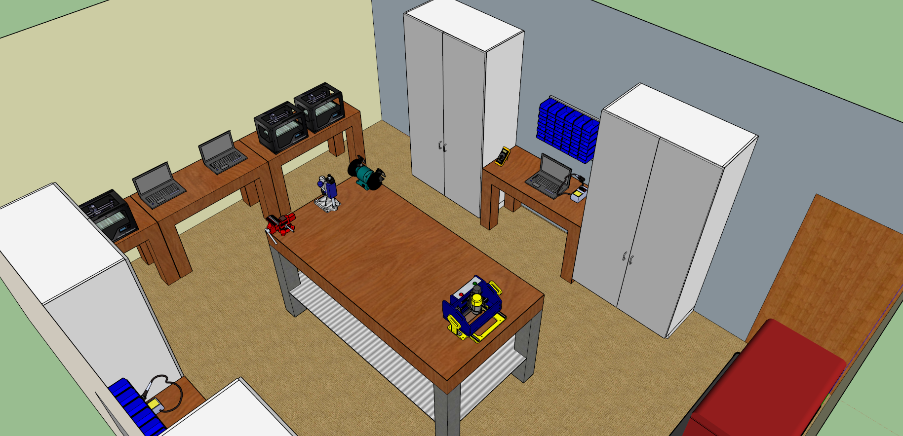
VIEW FROM SOUTHEAST

Slide 19
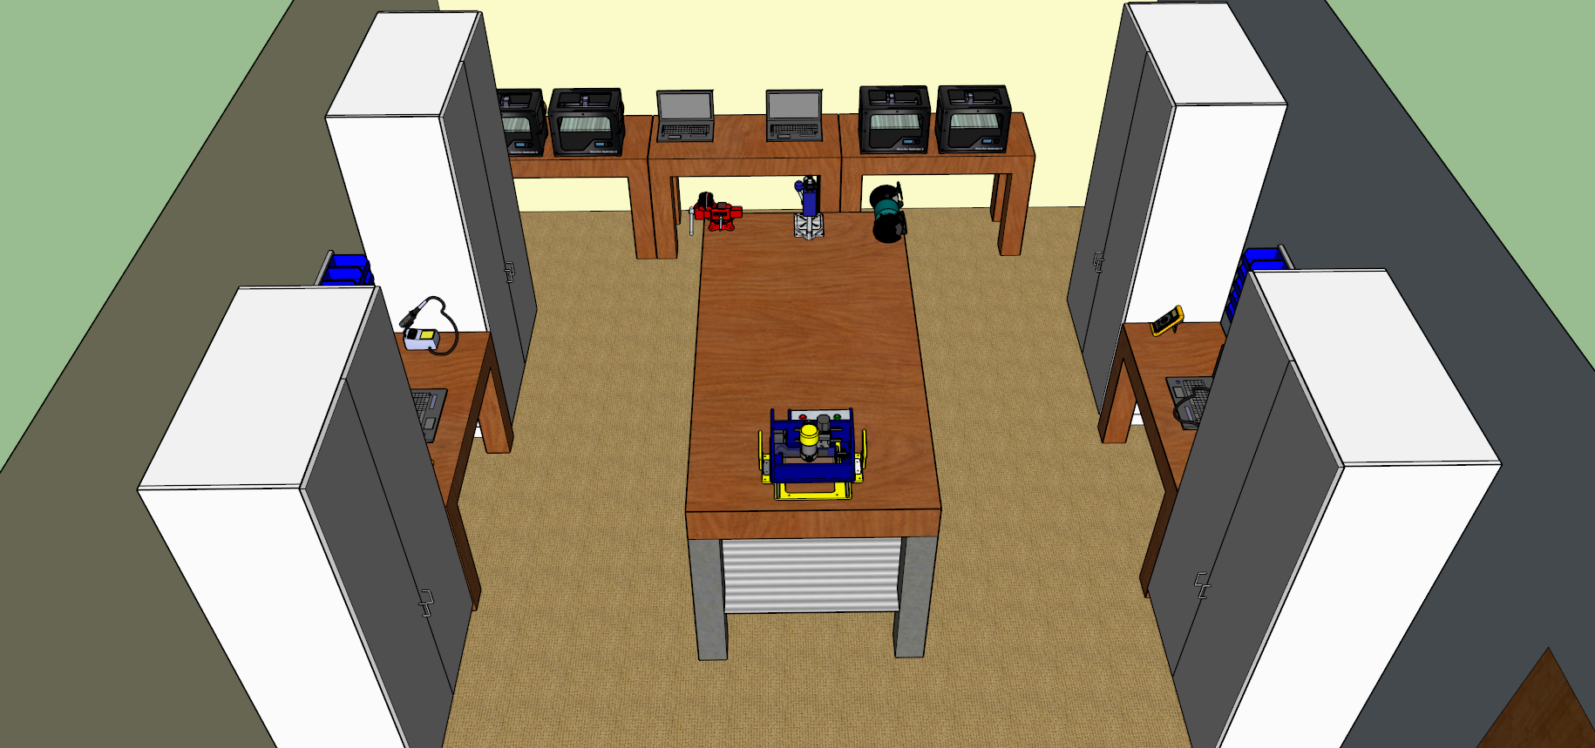
VIEW FROM EAST

Slide 20
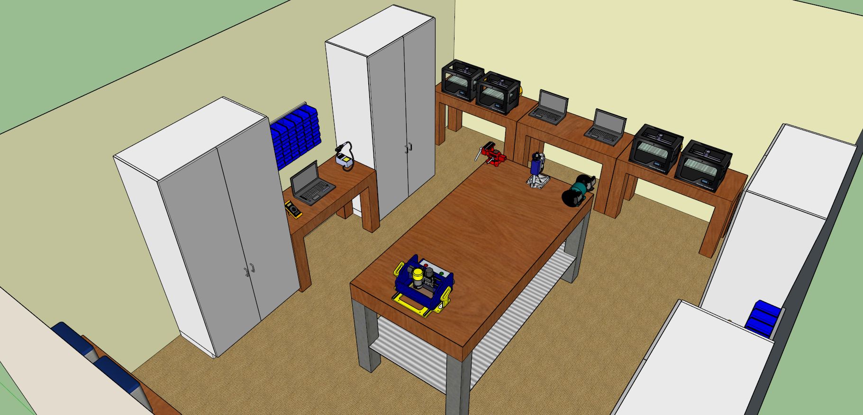
VIEW FROM NORTHEAST

Slide 21
ACKNOWLEDGEMENTS
DR. KATHY CARLISLE
THINC CEO
DR. CHRIS WILLIAMS
THINC DIRECTOR
JOE SUMNER
ENGINEERING DEPT. CHAIR
JANE ROBINSON
GRANT WRITER
THINC MECHATRONICS STUDENTS
DRAFTING & DESIGN

