Slide 1
Reagan ECHS
MakerSpace Proposal
May 7, 2016

Slide 2
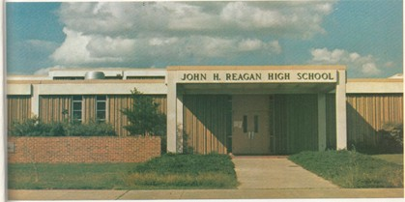
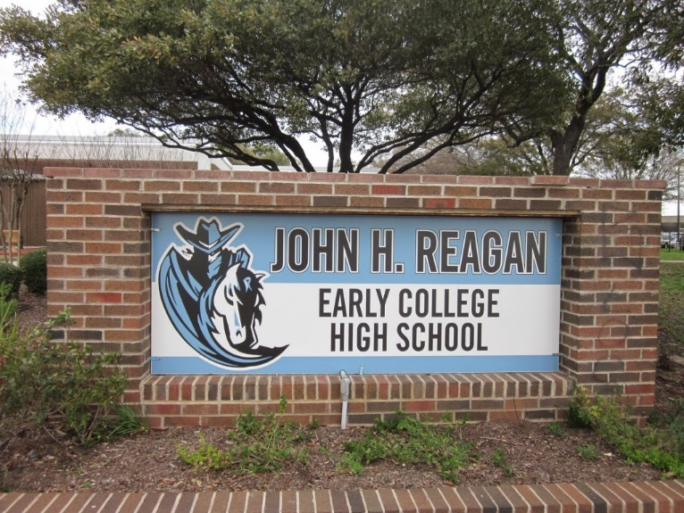
Reagan High School
1200 students
#ReturnofReagan
Want to encourage student creativity
Majority of students currently lack access to high tech tools

Slide 3
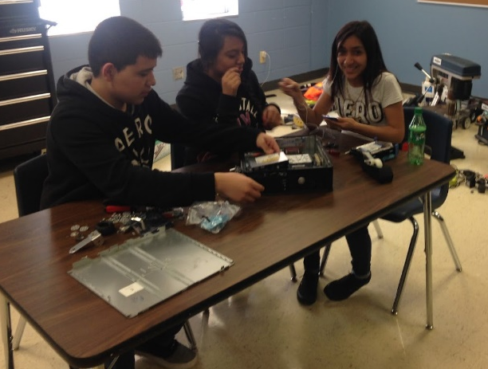
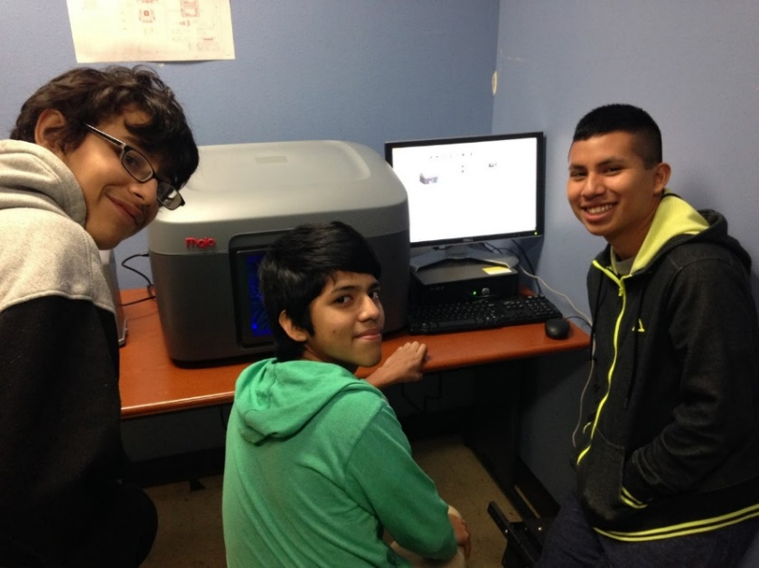
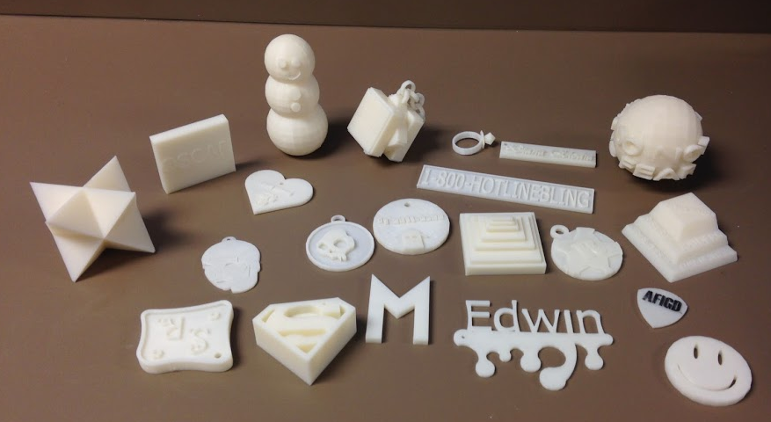
Current Projects that can reach more students with a makerspace
CAD and 3D-Printed models
Computer Assembly and Disassembly
Android Application Development
Robotics

Slide 4
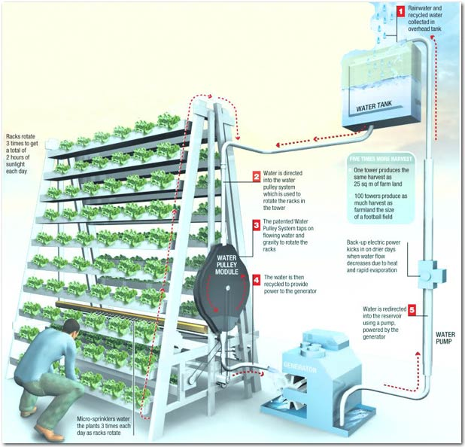
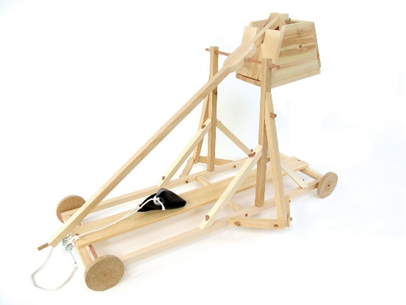
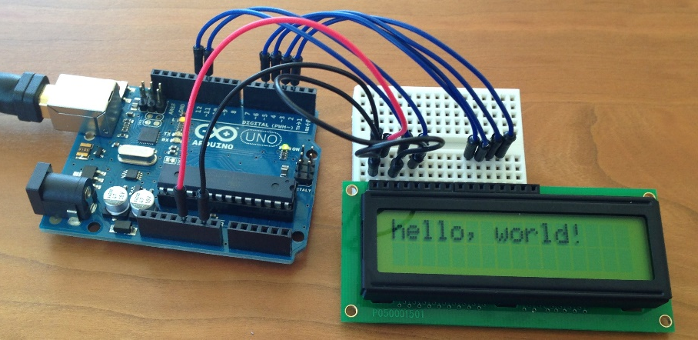
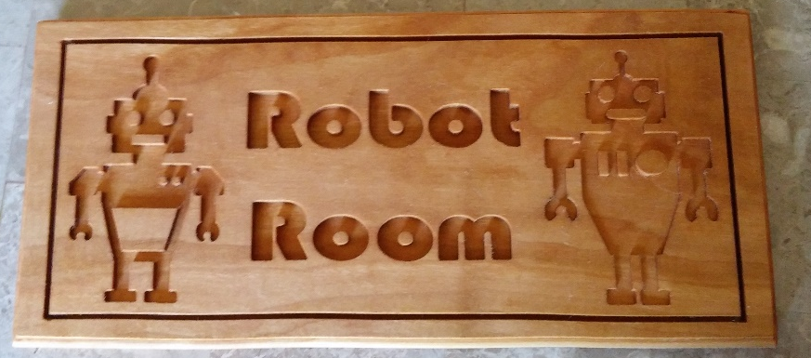
Future Projects that can be enabled by a makerspace
Urban Farming and Aquaponics
Custom-made signs and plaques
Electronics programming (Arduino)
Student-generated projects
Notes:
Ms. Hamm was awarded a grant for Urban Farming projects but they do not have a space to build or house the apparatuses.

Slide 5
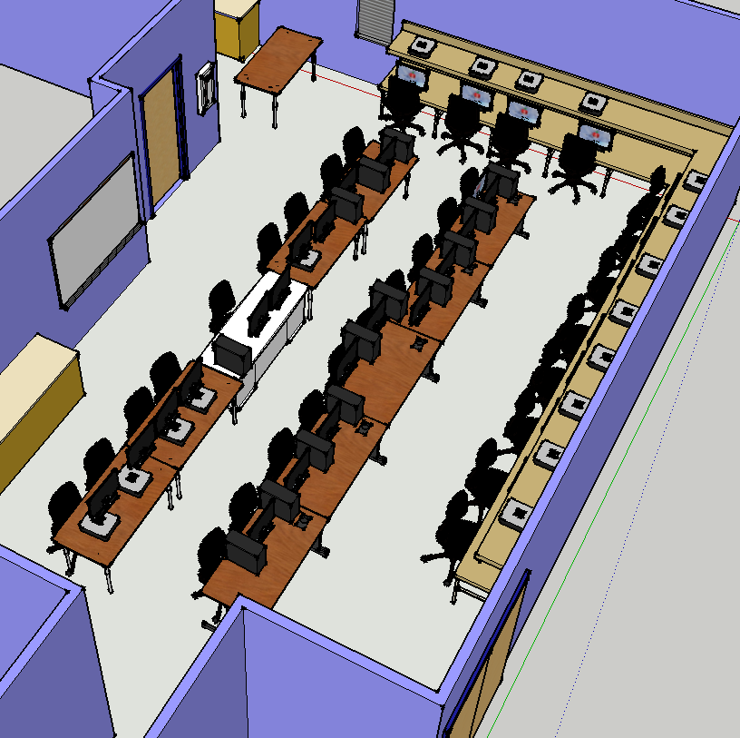
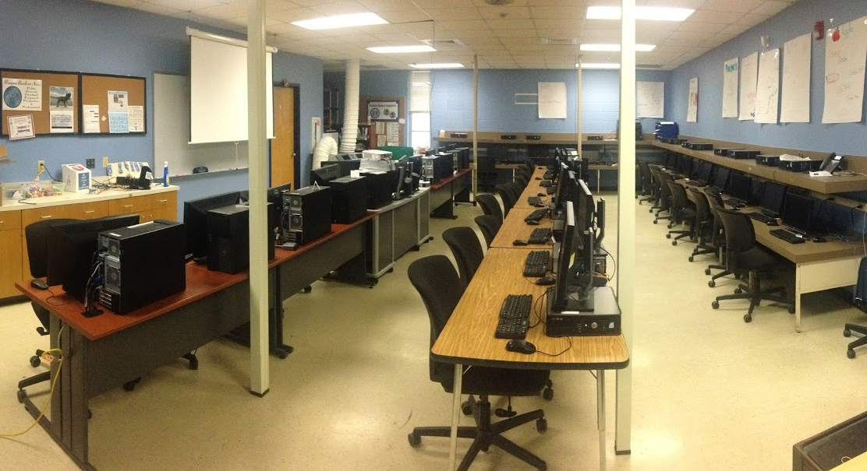
The Space for the Makerspace
Computer Lab
Notes:
Campus administration has already showed support for creating an open lab space for engineering classes and student projects.

Slide 6
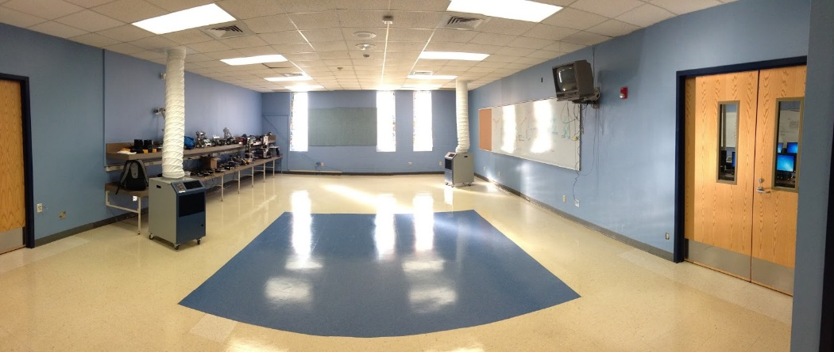
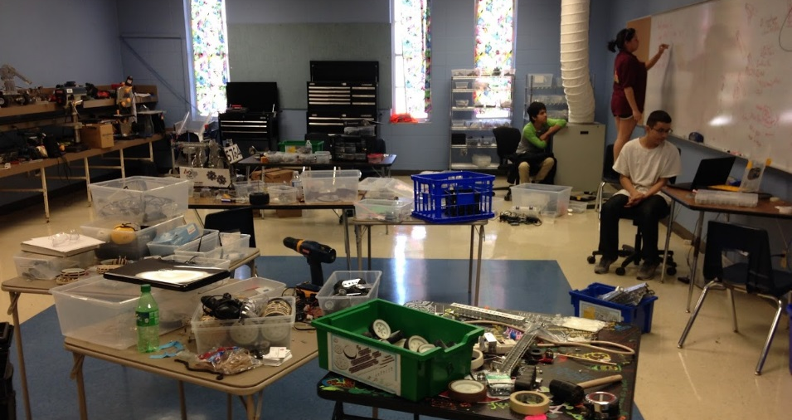
The Space for the Makerspace
Workspace
Notes:
Campus administration has already showed support for creating an open lab space for engineering classes and student projects.
We have some tools but are lacking a good place for them and robust worktables for projects.

Slide 7
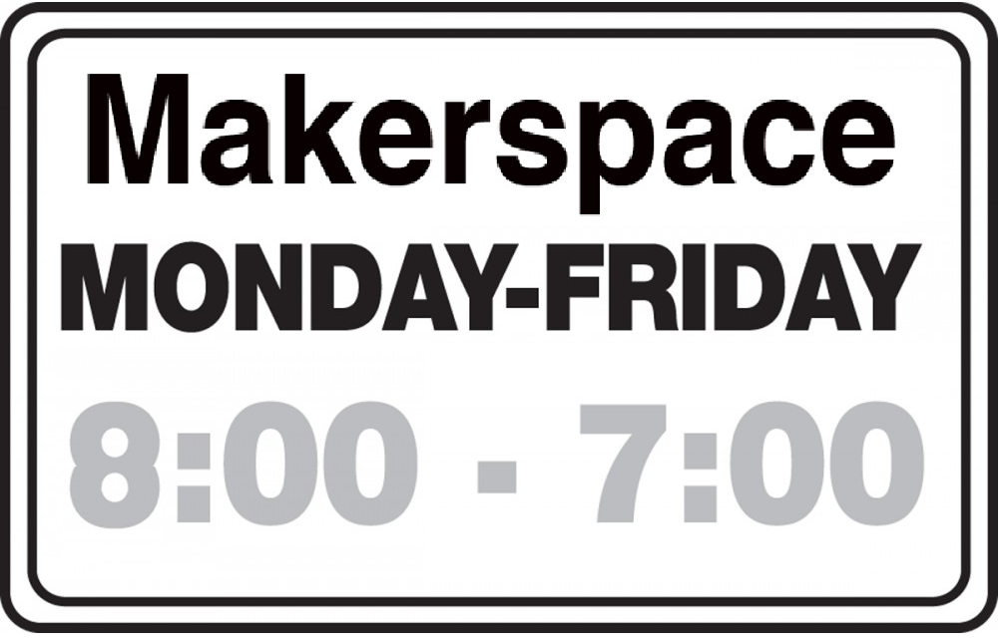
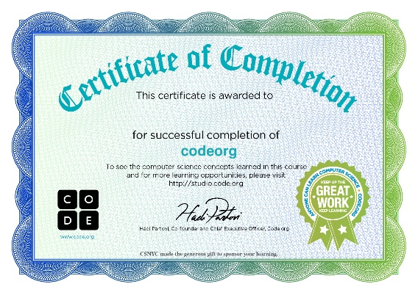
Library Model with Student Leads
Open Before and After School
Certified Student Leaders to provide expertise and instruction
Rotating Teacher Duty
Notes:
The Library is open to students before and after school.
There is one librarian who is helped by student aids. One of our robotics seniors is a library aid and suggested the same model to us. We liked it.
We don’t have a single full-time Makerspace staff, so our teachers will rotate who stays. We have a list of them later.
Here Alex is taking the lead teaching a family about robotics at Hope Fest last October.

Slide 8
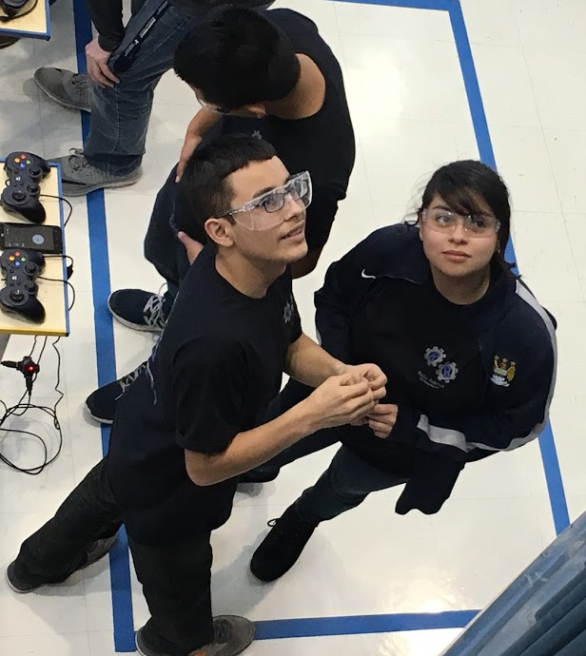
Eduardo Jaimes
Four years on the Robotics Team
Reagan didn’t have the space or equipment available to work on personal projects in the off-season
“I would like younger students to have the opportunity that I didn’t have”
Notes:
Senior who’s only outlet for hands-on was robotics team
But that’s only in the fall. “I would have liked to come in and build my own projects in the spring. If I had a space like this I would have. let the future generations after me have what I didn’t have. ” If I only knew it existed the opportunity to be successful in life.
But we didn’t have the structure / tools to reach our goals in life.

Slide 9
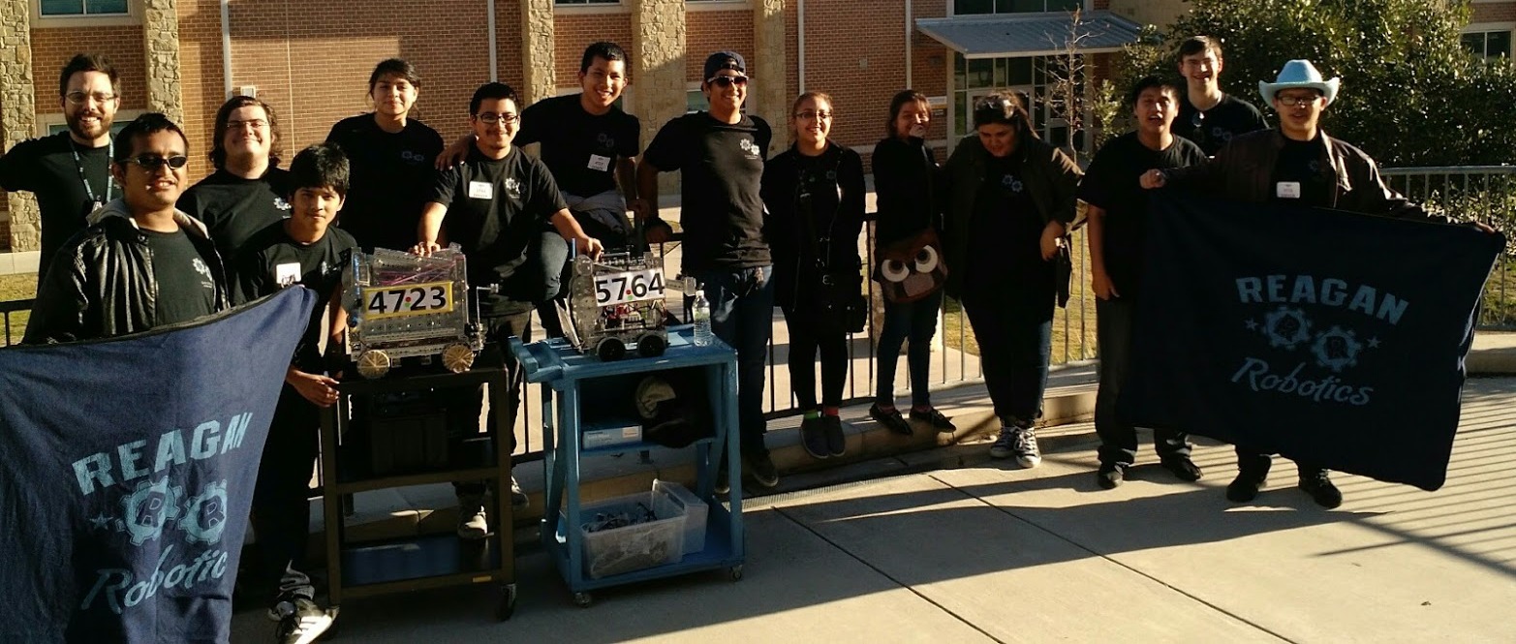
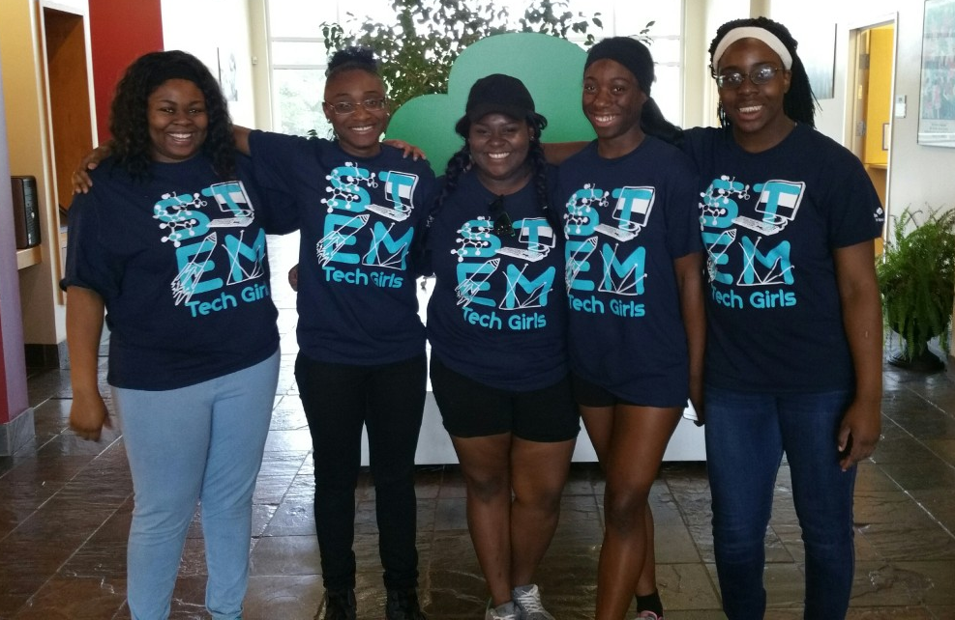
Existing Student Groups to Pilot
Robotics
Tech Girls
Notes:
Robotics, Tech Girls, Art Club and Entrepreneurship Students

Slide 10
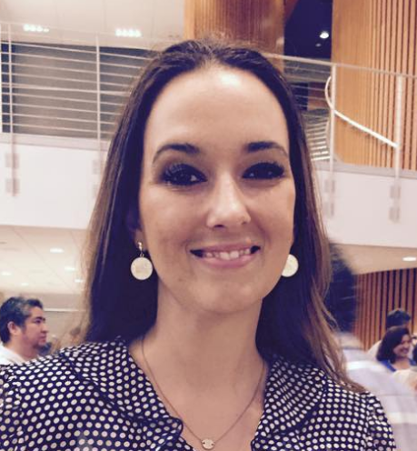
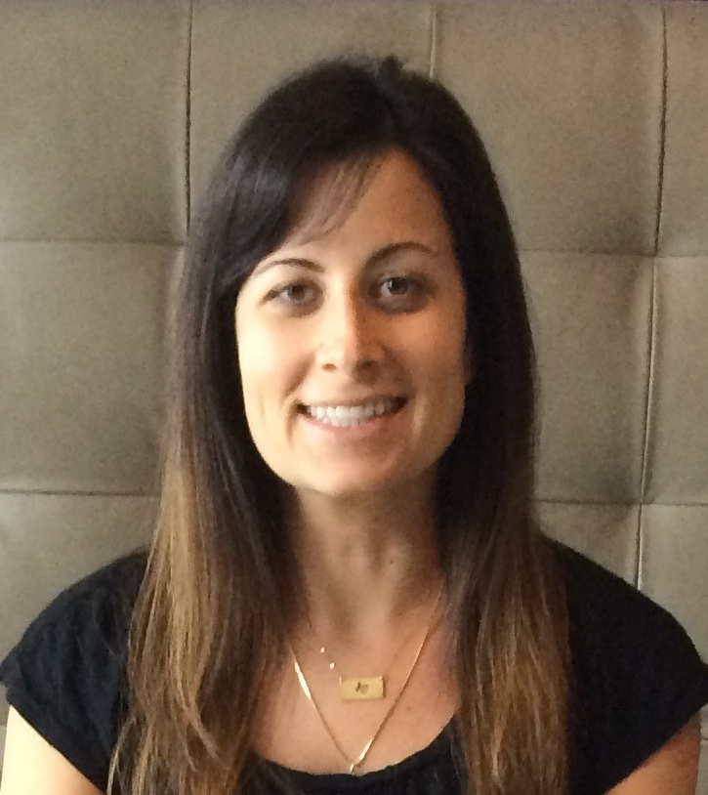
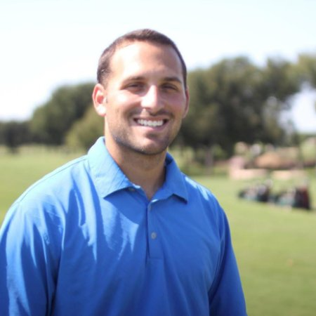
Makerspace Faculty Core Team
Jesse De La Huerta
Academic Director
Tina Hamm
Science Dept. Chair
Jonathan Hallmark
Science Teacher
Desirae Hendricks
Science/CTE Teacher
Jenny Stirrat
Librarian
Nick Lebo
CTE Dept. Chair
Eric Shaffer
Engineering Teacher
Shane Rosenkrantz
Math/CTE Teacher
Notes:
Team

Slide 11
Thank you very much

Slide 12
That was the student presentation
The previous slides were presented by a team of three students on May 7, 2016 at the Austin ISD Innovation Summit
Itzel Castilla, 10th grade
Yamilexis Rangel, 10th grade
Eduardo Jaimes, 12th grade
At the end of the day Reagan was awarded $2,000 to build out the vision for this makerspace

Slide 13
Future Vision
Students in Mr. Shaffer’s engineering classes created their own models of the makerspace they envisioned.
The next slides are selections of the compiled SketchUp Model of the makerspace inspired by these students’ creations and teacher input.

Slide 14
Overview
Notes:
Two Rooms: Computer Lab on the left and Makerspace on right, connected by interior double doors.

Slide 15
Area 1: Computer Lab
Notes:
The Computer Lab was modeled as part of Mr. Shaffer’s engineering class in Fall 2015 because it was converted to a full computer lab.
There is a storage closet behind the teacher’s desk that will be used for class projects, leaving the other storage rooms for the makerspace.

Slide 16
Area 2: Laser Cutter + 3D Printers
Notes:
This room contains the Computer Aided Manufacturing hardware that require a clean room: 3D Printers and the Laser Cutter. A storage closet contains extra filament.

Slide 17
Area 3: Workshop
Notes:
This area contains a wall-mounted shelving unit for all fixed power tools, a dust collection system and air filtration system.
Common hand tools are stored in peg-board sliding cabinets along the wall.
The CNC Router is situated next to the wall and dust filtration system with bit storage directly above it.
Workbenches take up the main floor space.
Whiteboards are along the other wall to allow student brainstorming and ideation.

Slide 18
Area 3: Workshop Angle 2
Notes:
This area contains a wall-mounted shelving unit for all fixed power tools, a dust collection system and air filtration system.
Common hand tools are stored in peg-board sliding cabinets along the wall.
The CNC Router is situated next to the wall and dust filtration system with bit storage directly above it.
Workbenches take up the main floor space.
Whiteboards are along the other wall to allow student brainstorming and ideation.

Slide 19
Area 4: Entryway and Supplies
Notes:
As students enter on the right will be a sign-in desk, which is also where students record any service requests for tools or request additional supplies.
Above the desk is a bulletin board with the makerspace schedule, rules, relevant news and upcoming events.
On the left is a storage closet which will contain all of the common school and craft supplies that do not need to be controlled.

Slide 20
Area 5: Raw Material Storage
Notes:
Behind the sign in desk is a storage room for all large raw materials: wood, PVC, sheet plastic.

Slide 21
Area 6: Project Storage
Notes:
Behind the office supply shelf is a storage closet that students will use to safely lock and store their projects.

Slide 22
Student Credits
Measurement and Creation of Sketchup Model of Makerspace Room:
J Severiano Acevedo Hernandes, 10th grade
Eriverto Martin Adame Vences, 10th grade
Daniel Morones-Ortis, 11th grade
Abel Jiminez Reyes, 11th grade
Additional Sketchup Design Contributions
Mr. Shaffer’s 7th and 8th period Concepts of Engineering

