Slide 2
Transforming Library Space for STUDENT AND Community Engagement
A cte Makeover challenge project
Clearwater R-1 School district
Piedmont, Missouri

Slide 3
Overview
A small school can have a big impact in the lives of students and the town in which it operates.
The CTE Makeover Challenge is part of a comprehensive program to create a modern learning environment that encourages and equips students living in Piedmont, Missouri with career skills in a community plagued by low income.

Slide 4
Framework for Success
Beginning in 2014, the Clearwater R-1 School District administration and board members made the commitment to update technology and infrastructure within the school.
Fiber optic cable was put in place, a number of laptops and chromebooks were purchased, and a network was established to support the equipment.
These changes were made despite tough finances, because priority has been placed upon fulfilling the need to prepare students with skills necessary for academic and career success.

Slide 5
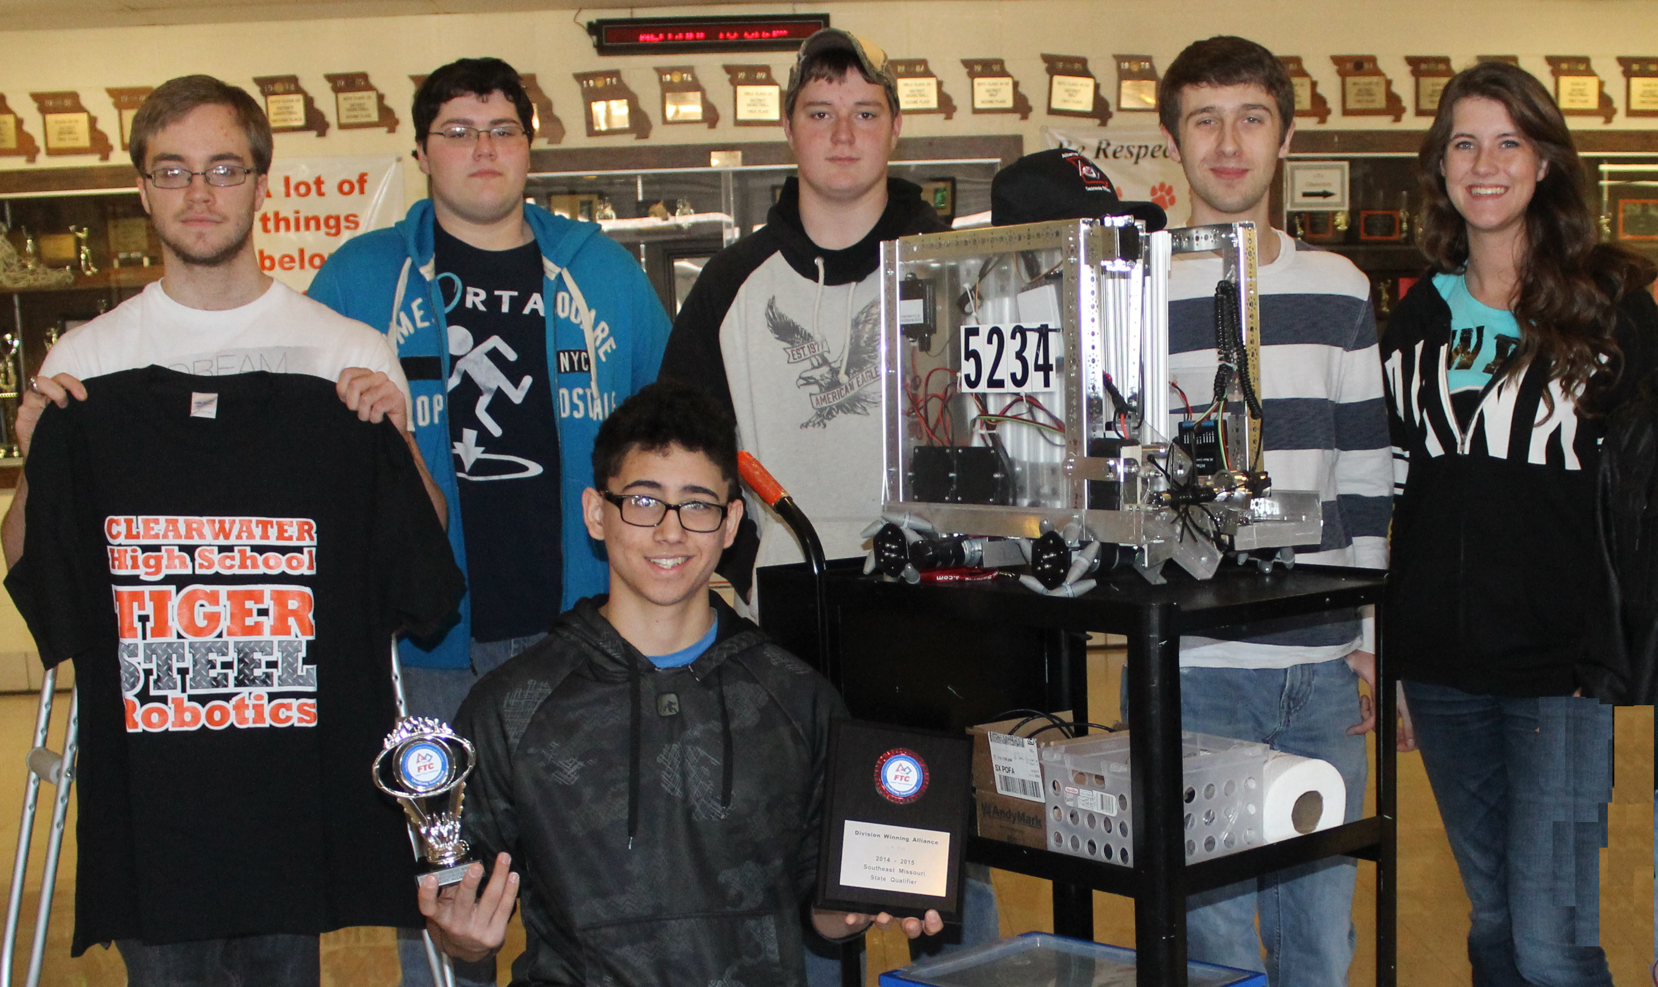
Framework for Success
Tiger Steel Robotics was established in 2012.
In 2015, the team qualified for state competition in the Missouri FIRST® Tech Challenge Championship for the first time. They advanced to finals and finished 12th in
their division.

Slide 6
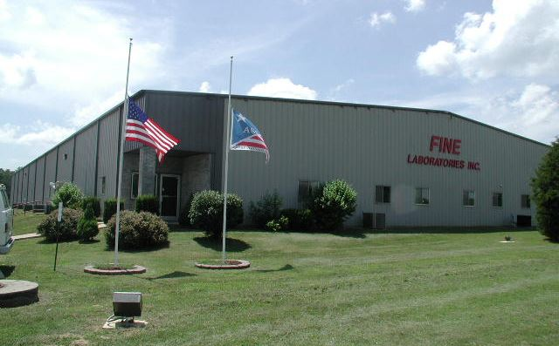
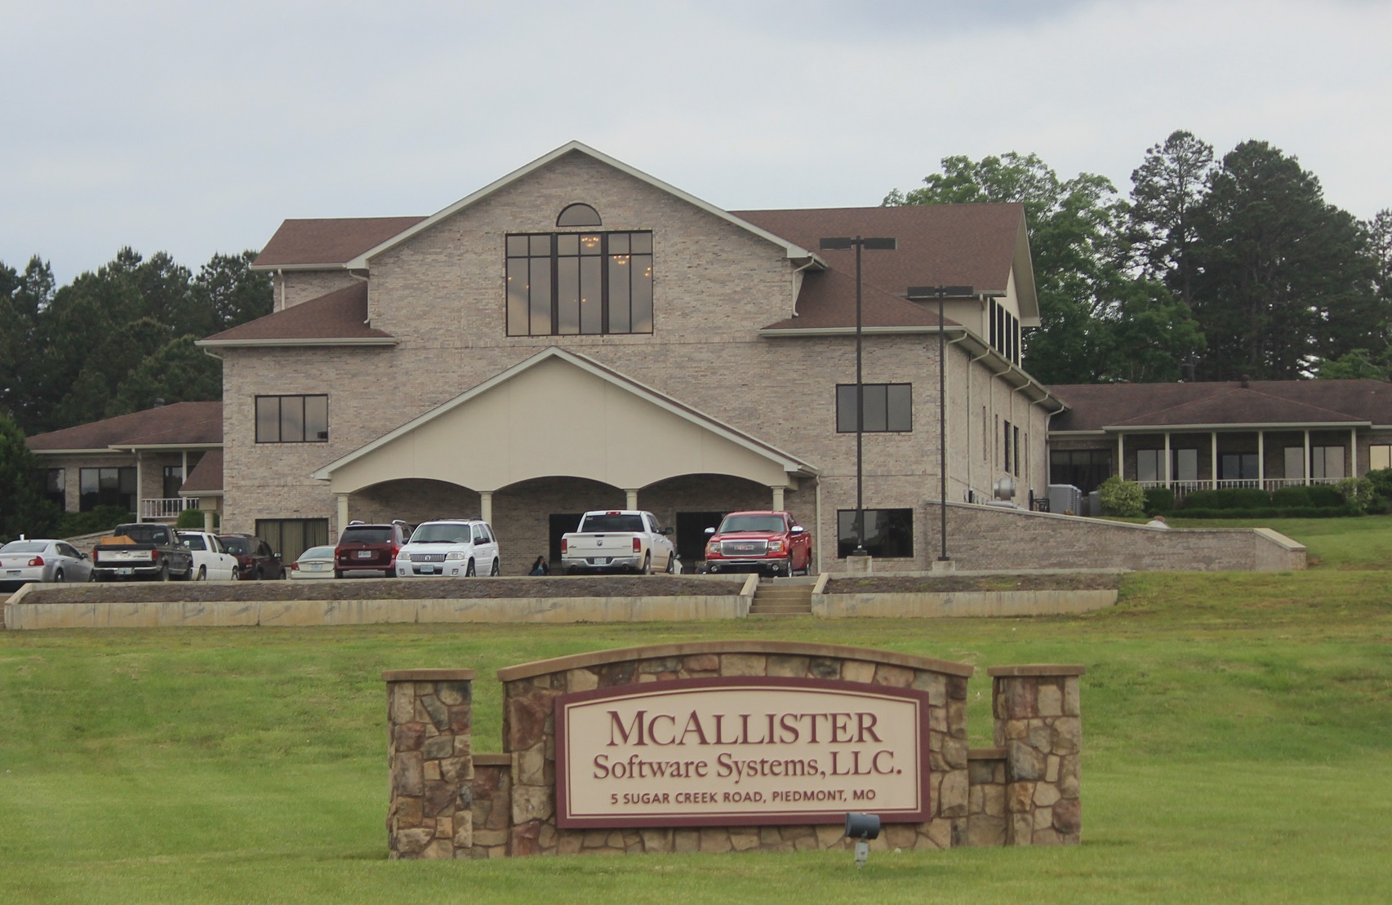
Framework for Success
An expert panel of team members has come together, including vocational, science, math, and other educators, parents, students, and community members from the local US Army Corps of Engineers and area industries including Fine Laboratories, McAllister Software, and Toyoda Gosei Co., Ltd.

Slide 7
Framework for Success
Engineering byDesign™ (EbD) coursework has been added to the high school curriculum for the 2016-17 school year and a full time teacher has been assigned.

Slide 8
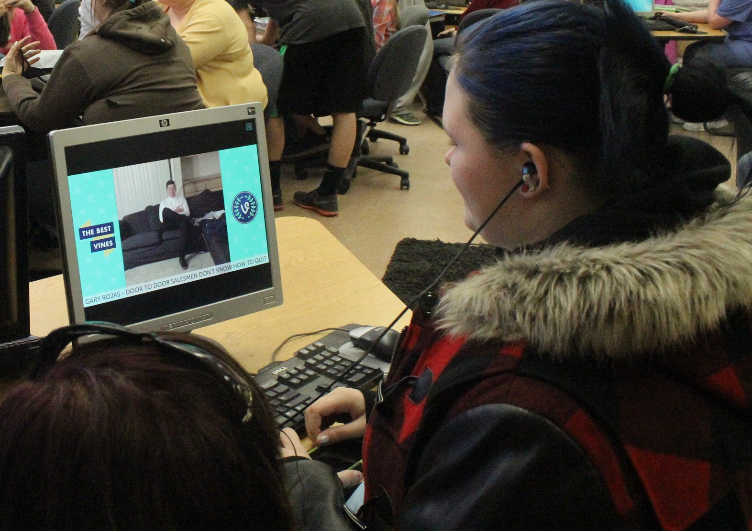
Framework for Success
Courses added at the Middle School level for 2016-17 are:
Coding
Introduction to Media
Web Page Design

Slide 9
Framework for Success
The CTE Makeover Challenge Project will go hand in hand with a Lowe’s Community Grant Project awarded in April 2016 designed to change the Clearwater High School Library into a “student and community-centered, flexible space with an inviting atmosphere that accommodates a variety of activities.”

Slide 10
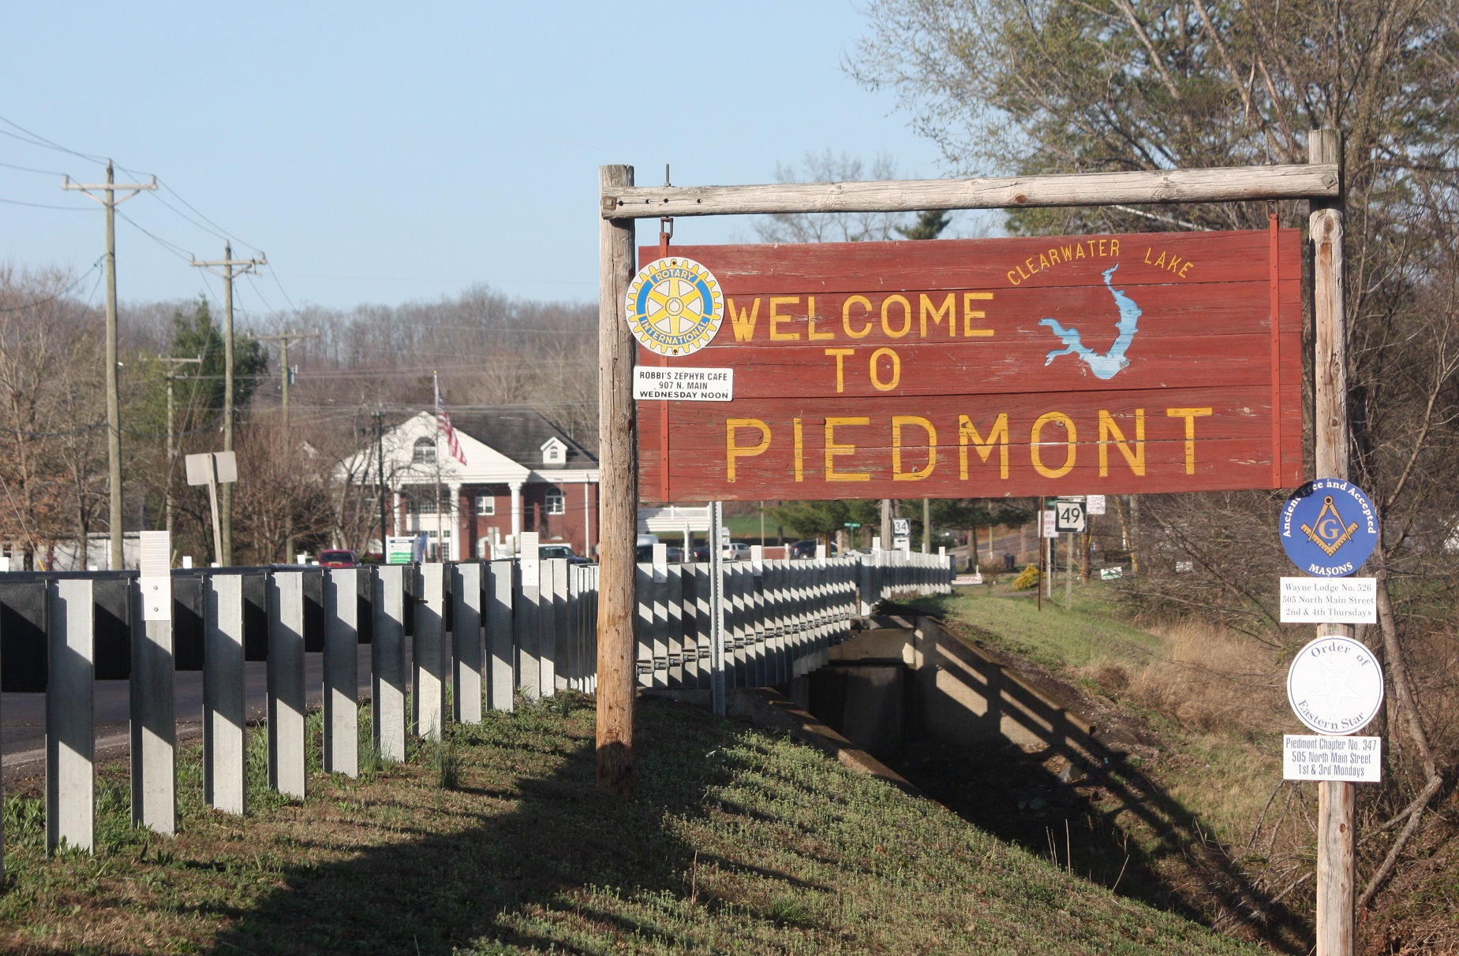
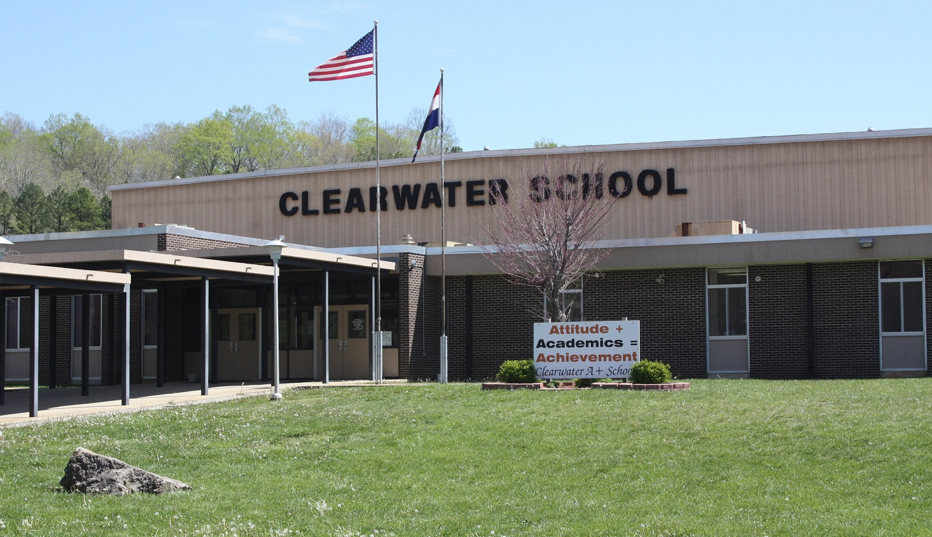
Community/School Collaboration
The small town of Piedmont, Missouri embraces the school and its endeavors.

Slide 11
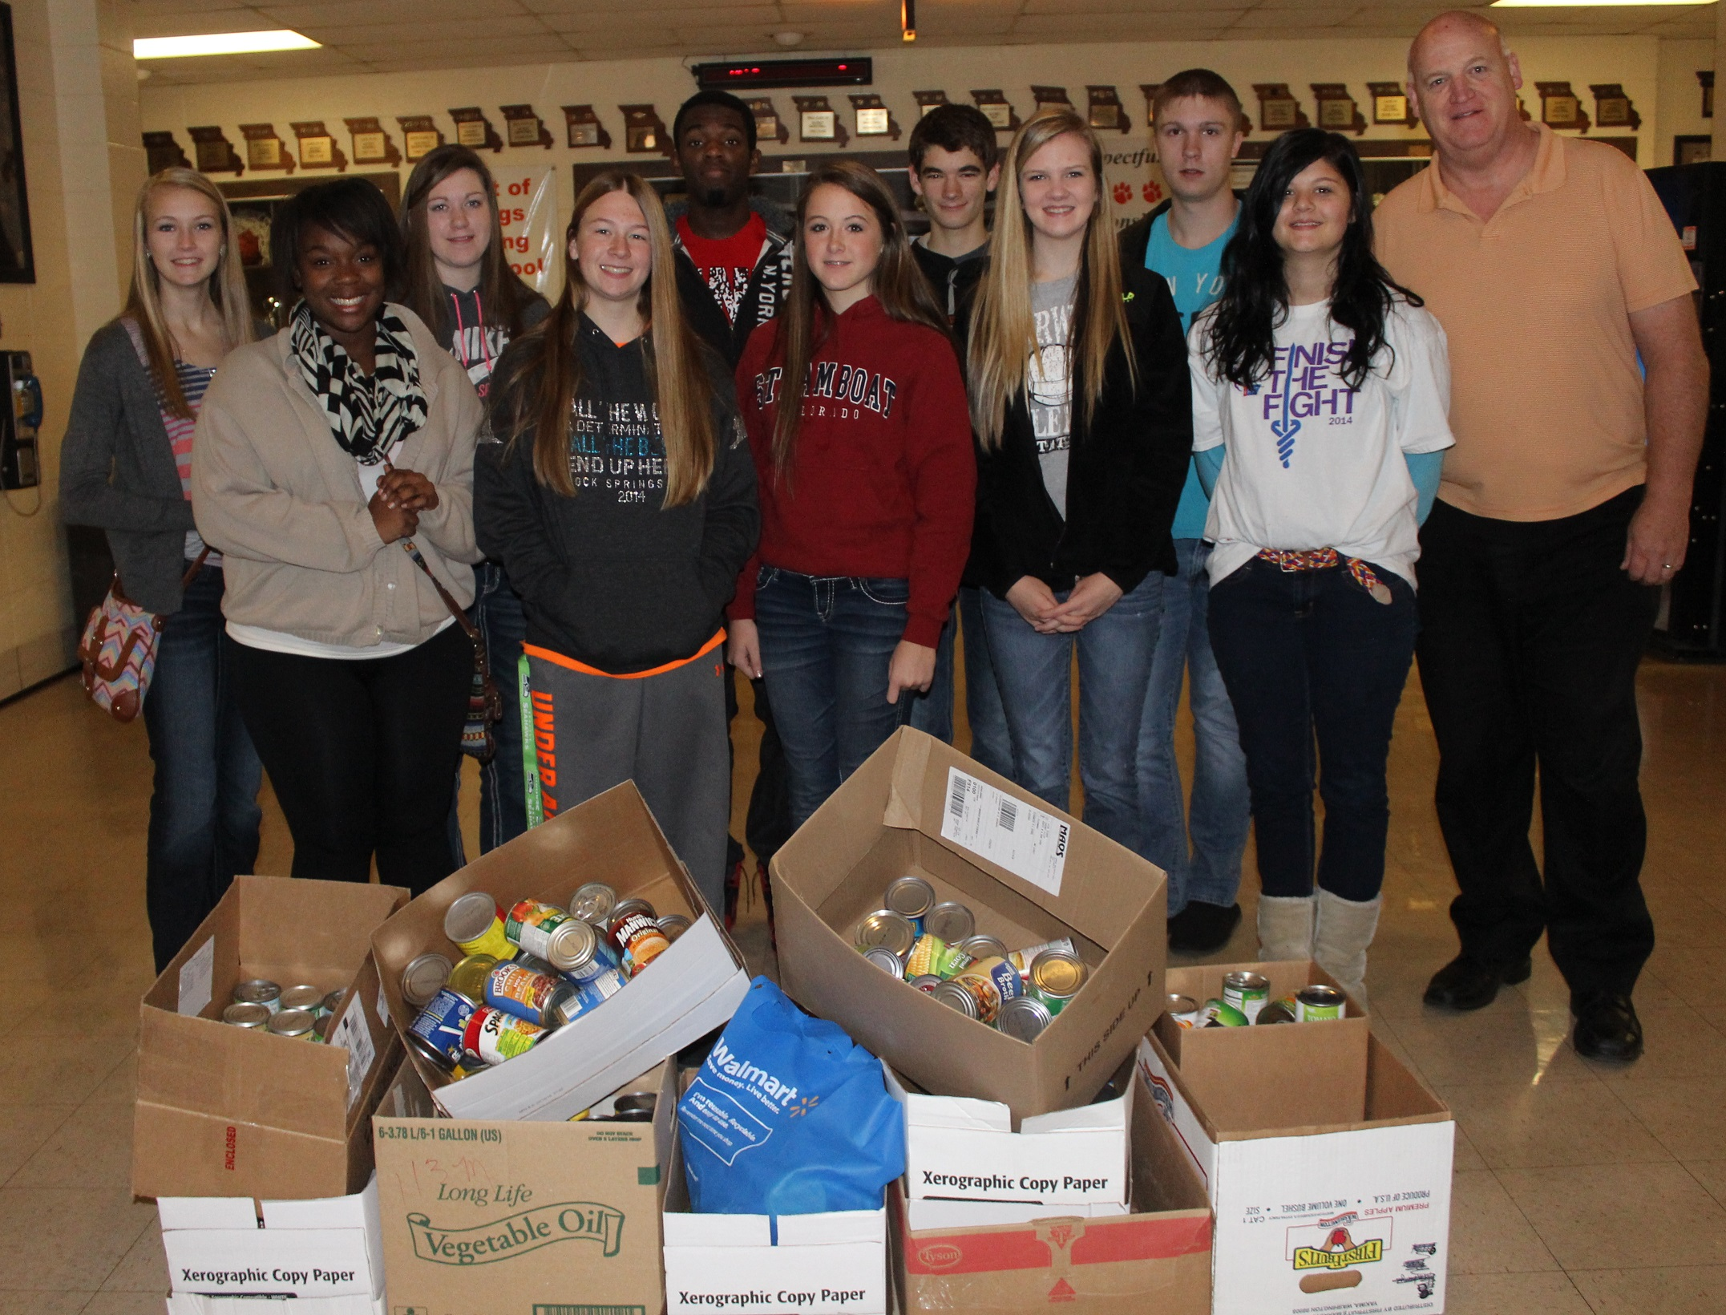
Community/School Collaboration
In return, students and teachers work together for the good of the community.
Sharing scarce resources is a necessity.

Slide 12
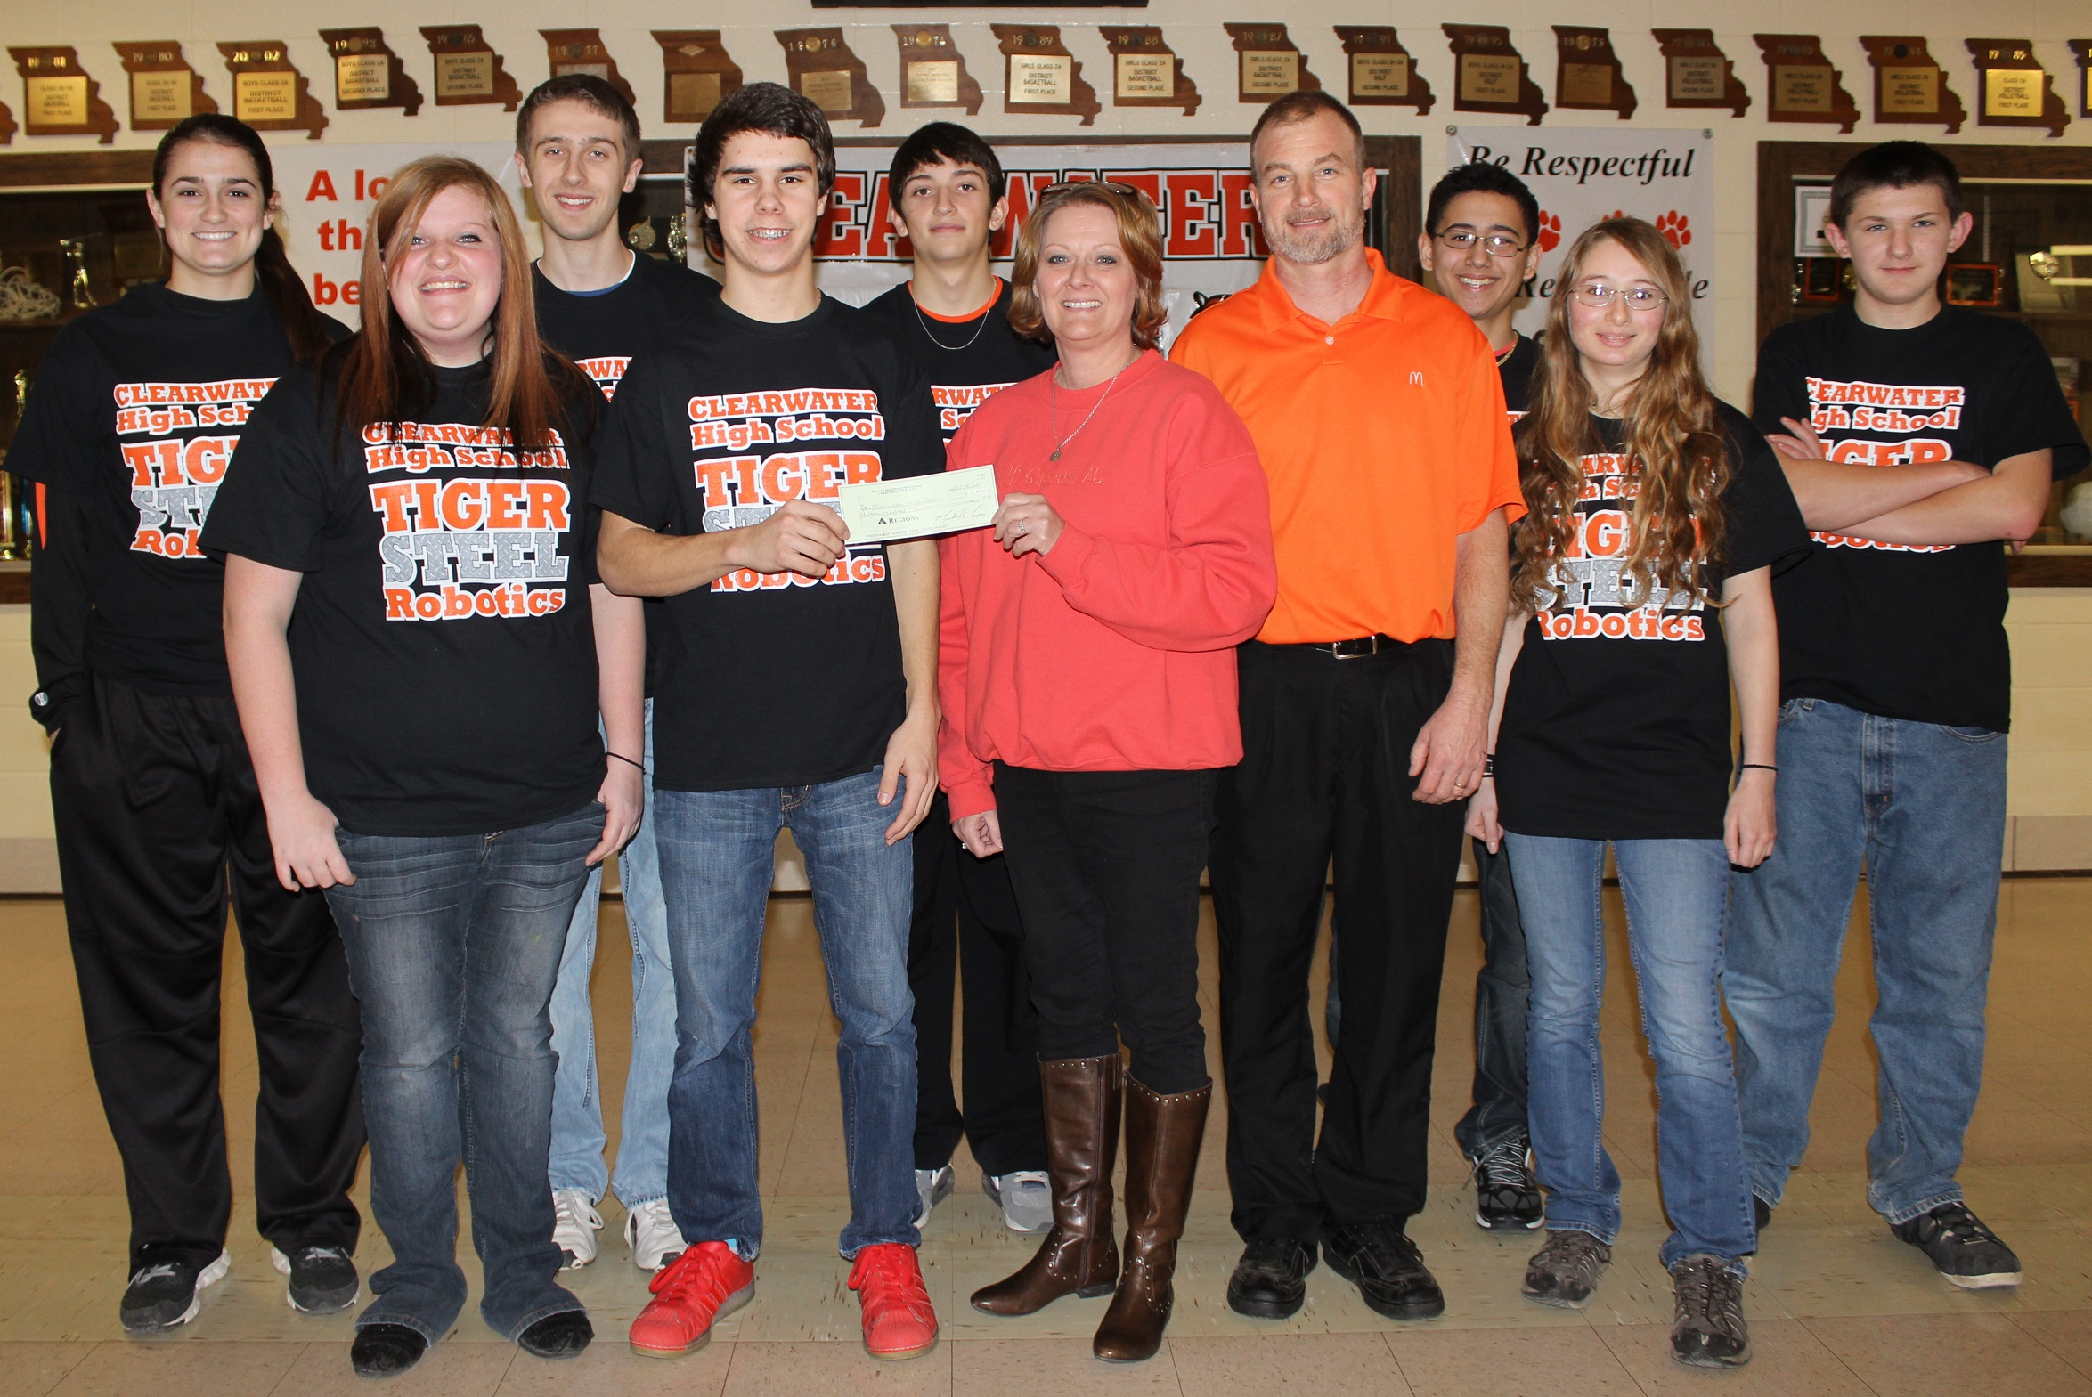
Community/School Collaboration
Just as many past projects have been joint efforts, “Transforming Library Space for Student and Community Engagement” will be a collaborative effort between the school and community.

Slide 13
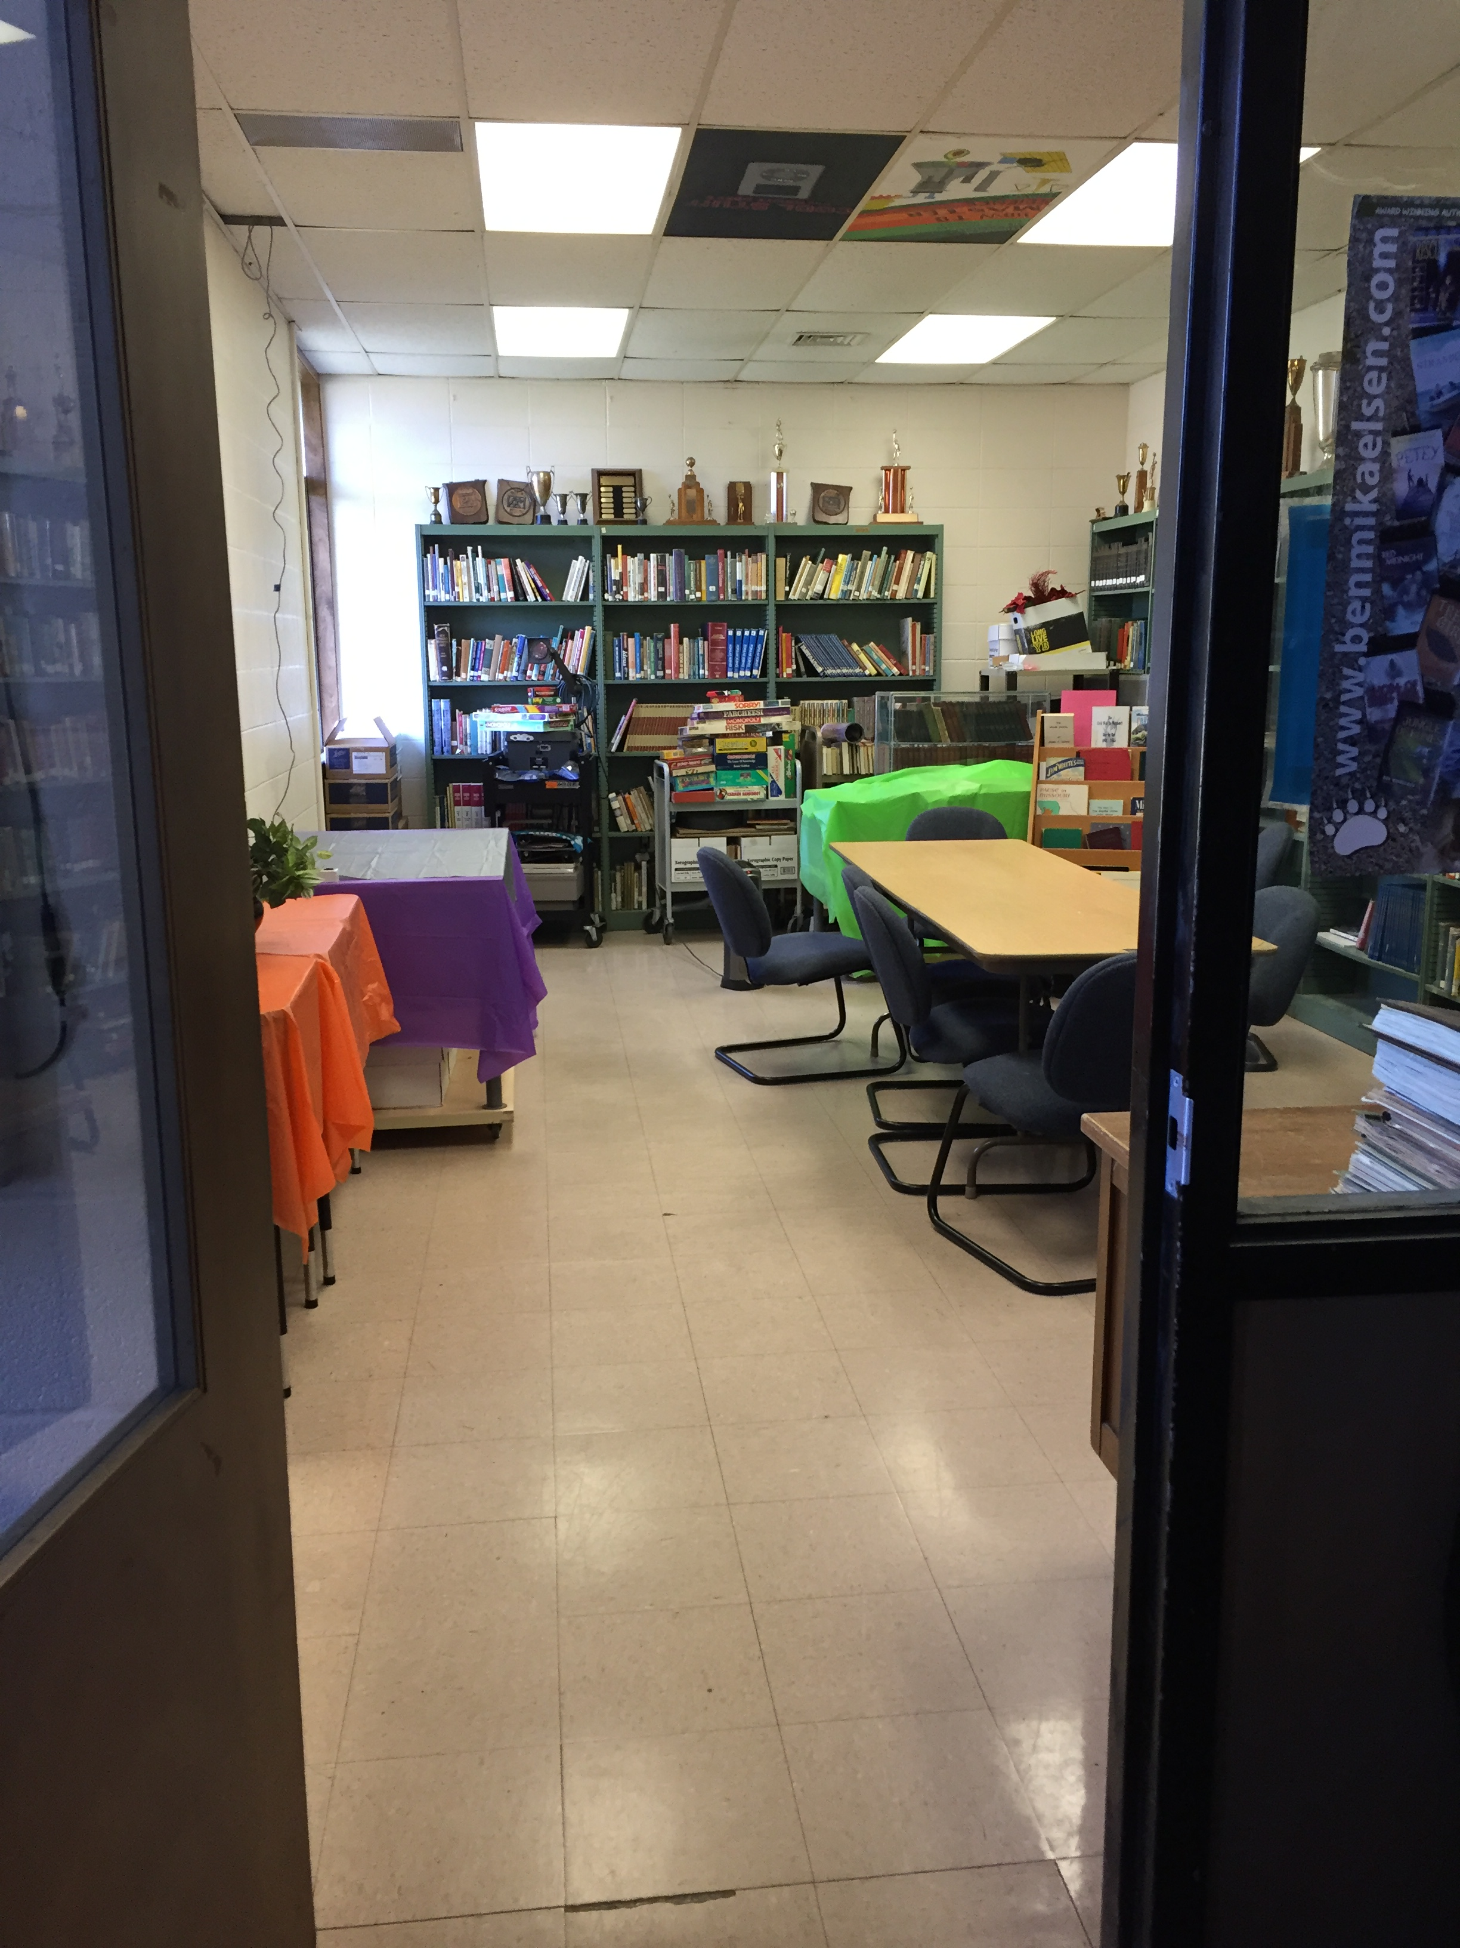
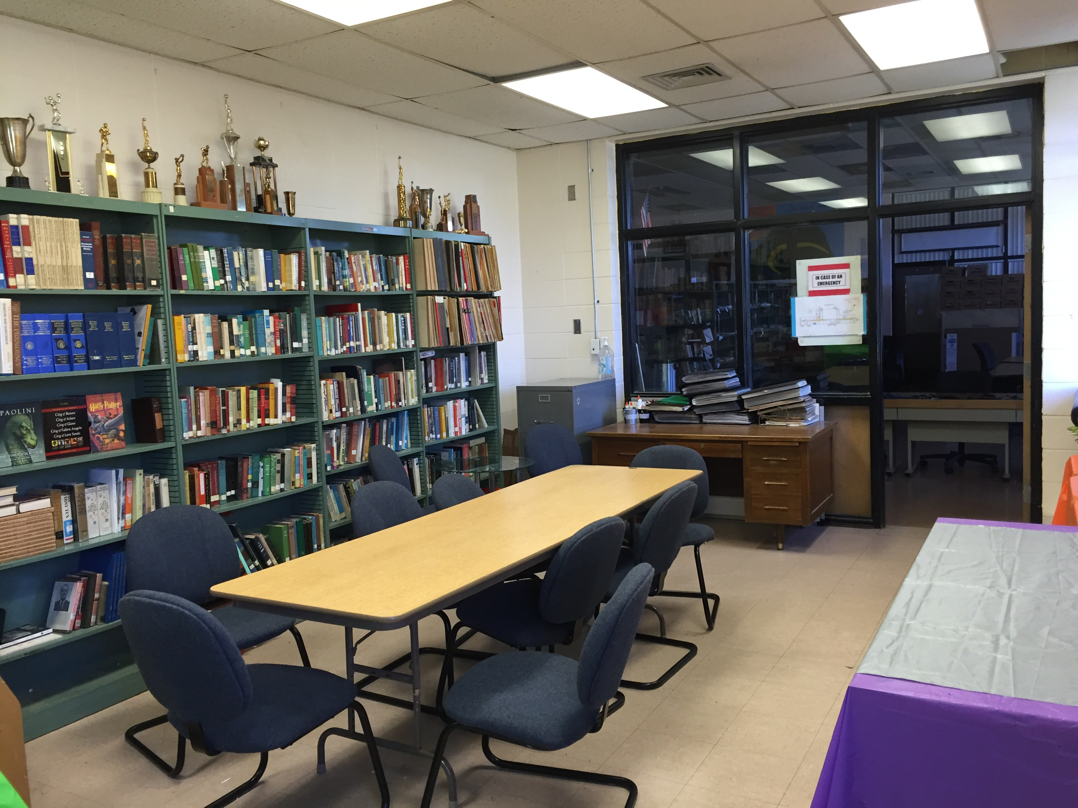
Area for the Proposed Makerspace

Slide 14
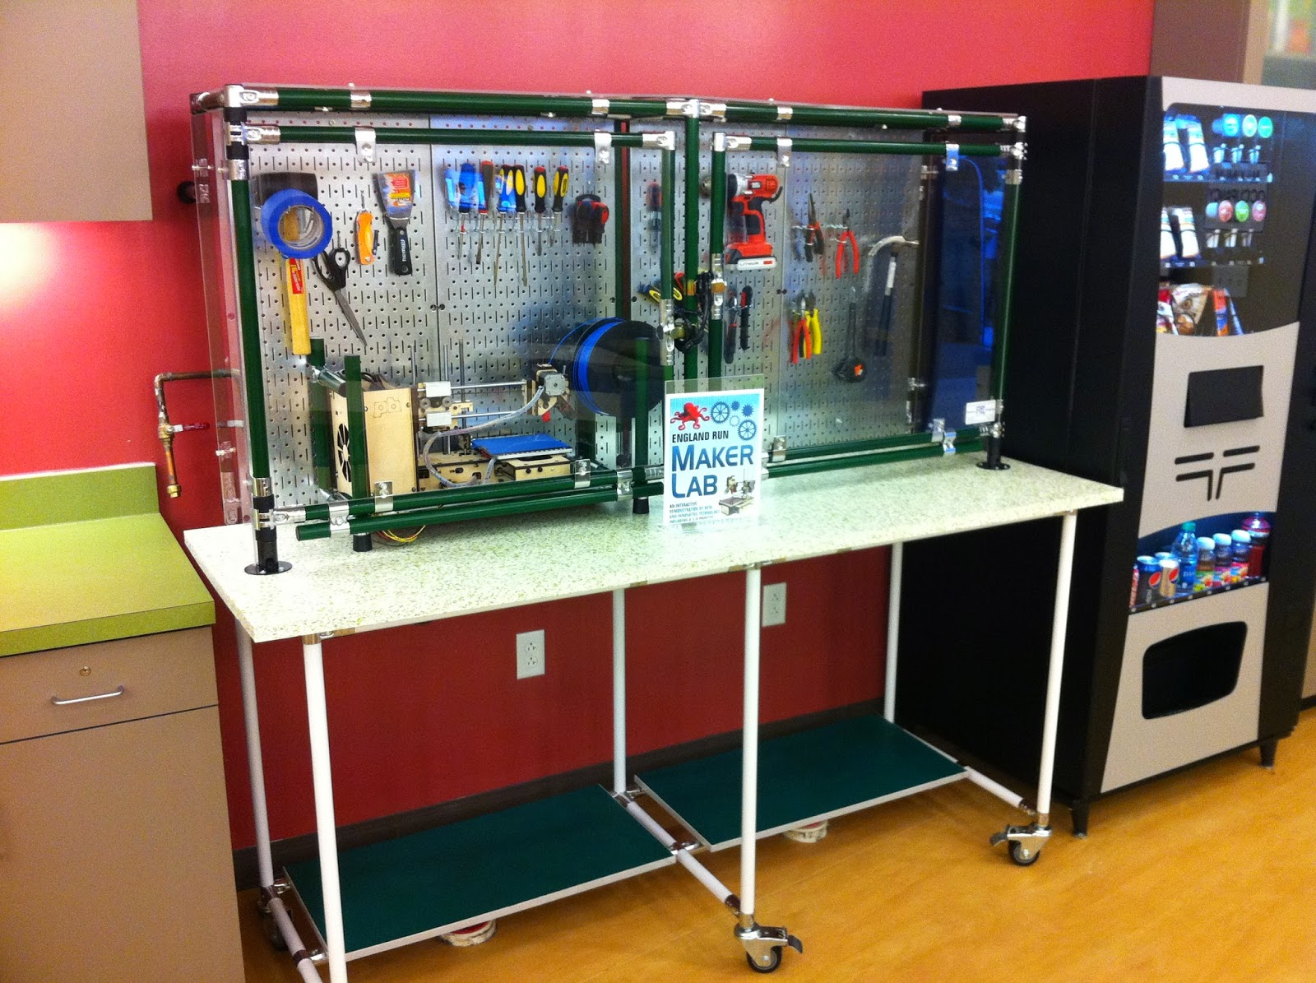
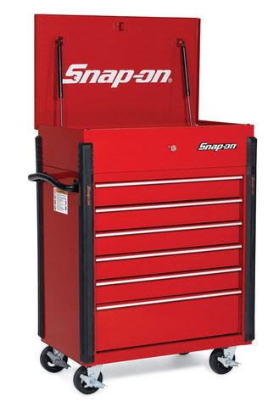
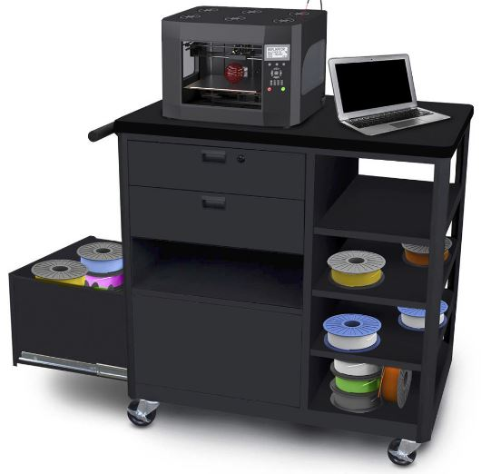
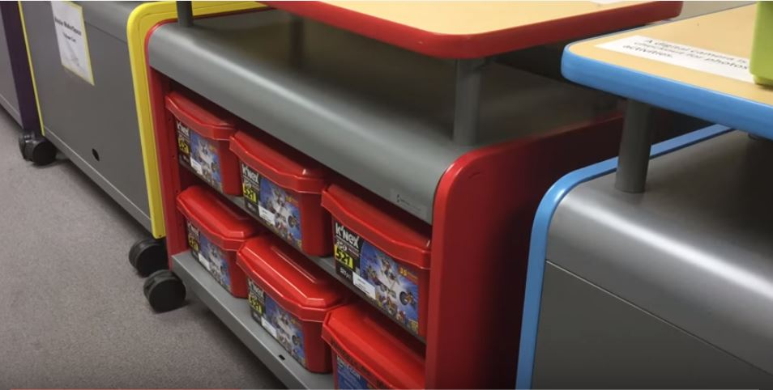
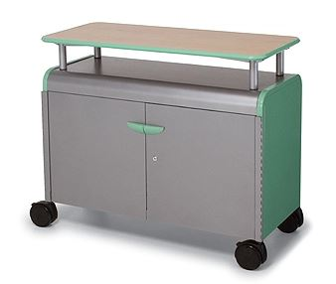
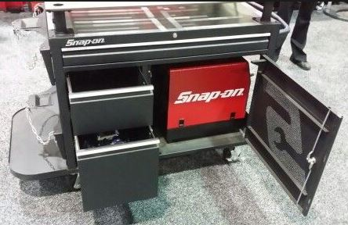
Flexibility & Mobility
Students may come to the workspace or the workspace may be transported to the students.

Slide 15
Innovative
Space is both flexible and mobile.
Strong collaboration with the community is a key factor.
Creative stations will be used to develop real world solutions to real problems, meeting the needs of both the school and surrounding community.
An entrepreneurial component for sustainability will address product development, marketing, public relations, and economics.

Slide 16
Replicable
Space is classroom sized.
Mobile carts can be moved to any space.
Schools can add one station at a time based upon financial ability.
Deconstruction zone has no cost other than the initial purchase of basic tools.
Video/Audio Production component can be replicated in a closet size space.
The model school is similar to many low-income, small public schools.

Slide 17
Multi-Functional
The variety of creative stations spans across the curriculum.
Various stations and even the same station, such as LEGO®, can cover a wide range of interests, abilities and grade levels.
The makerspace can be used by middle school students in the connecting building as well as high school students, thus doubling the number of students served.

Slide 18
Feasible
The budget is realistic.
The project has the full support of the school administration.
Community members have vocalized their support.
The space is readily available.
Team members are highly capable.
Additional courses have been put in place to assure highest usage of the makerspace.

Slide 19
Sustainable
Once the initial purchases of equipment are made, the makerspace will be supported by both the school and the community.
Eventually the makerspace is expected to be sustainable on its own through products created for the surrounding community and online community.

Slide 20
Need
The Clearwater R-1 School District is situated in the foothills of the Ozark Mountains, an economically disadvantaged area. According to the most recent data, the percentage of children under age 18 living in poverty is over 40%.
Nearly 70% of students qualify for the free/reduced lunch program.
There is no public transportation and little industrial development. The county served by the Clearwater R-1 School District is ranked 93 out of 115 in child well-being, with 1 being the best and 115 being the worst. (Missouri Kids Count Data, 2016)

Slide 21
Transforming Library Space for STUDENT AND Community Engagement
A cte Makeover challenge project
Clearwater R-1 School district
Piedmont, Missouri

